Slide 1
The impact of GDPR on Third-Party and M&A security
Dr Marco Ermini, CISA, CISM, CISSP, ITILv3, GCIH, RCSS, PhD
Senior Security and Compliance Officer, Orange Business Services

Slide 2
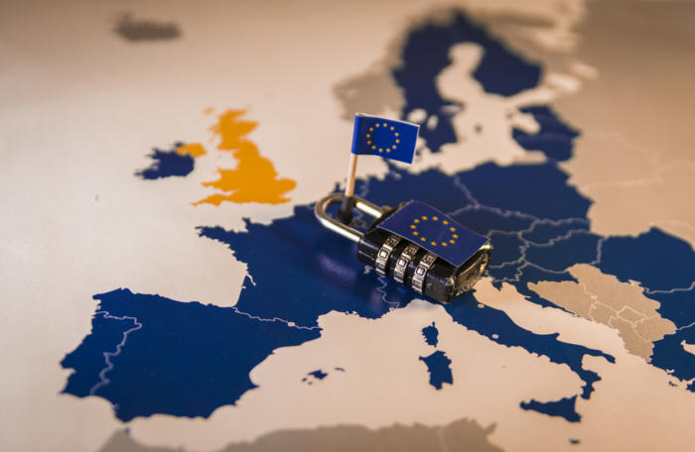
Take away
Describe the impact of GDPR on three different but connected business processes:
Mergers & Acquisitions (M&A)
Third-party security
Outsourcing security
Approaching an external organization is
going to be different after GDPR is in
force
Notes:
In this session, we are going to describe the impact of GDPR on three different but connected business processes: Mergers & Acquisitions (M&A), third-party security, outsourcing security. This has also indirect repercussion on Cloud programs, which are often used to fulfil those activities.
Approaching an external organization is going to be different after GDPR is in force, and this is one aspect that has been historically always overseen. The session will provide a practical demonstration of (vendor-agnostic) toolsets which can be taken into consideration for the purpose of performing those activities, as well as example policies and standards you can adopt in your organization tomorrow.

Slide 3
What is this all about?
GDPR impact has been mostly focused on technology
Understand the general impact of GDPR on M&A prospects
Impact of GDPR on third-party and outsourcing security
Identify specific GDPR programs, which affect third-party, outsourcing and M&A processes
What "privacy" means in the context of M&A activities, outsourcing and third-party
Notes:
GDPR impact has been dissected and examined to death, although, focus on technology. M&A activities, as well as third-party security posture, can be greatly affected as well, and this aspect has not been very often pursued. This session hopes to be useful for that.
Understand the general impact of GDPR on M&A prospects
Evaluate the impact of GDPR on third-party and outsourcing security
Identify if specific programs need to be set-up in your organization because of the GDPR, which ones affect third-party, outsourcing and M&A processes, and how
Get a clearer picture of what "privacy" means in the context of M&A activities, outsourcing and third-party involved in business processes

Slide 4

Let’s get started!

Slide 5
Setting the stage
Compressed GDPR
or
“GDPR for dummies”

Slide 6
Three Dimensions of GDPR
Legal. The GDPR is a law. This research note is not intended as legal advice or comprehensive guidance.
Procedural. (New) roles, responsibilities, accountabilities and processes to be implemented
Technical. The GDPR includes many data protection principles and requirements that must be enabled by technology, or that require technology to limit impact to internal operations
Notes:
The General Data Protection Regulation (GDPR) is a European law that has gone into effect on 25 May 2018. The GDPR has three dimensions:
Legal. The GDPR is a law. As proposed by the European Parliament, the GDPR will apply to all personal data, regardless of whether it is located inside the EU zone or transferred outside the EU zone. Of course, this research note is not intended as legal advice or comprehensive guidance.
Procedural. Depending on business and data volume, compliance with the GDPR may demand that (new) roles, responsibilities, accountabilities and processes be implemented.
Technical. The GDPR includes many data protection principles and requirements that must be enabled by technology, or that require technology to limit impact to internal operations. For example, technical professionals can support the GDPR program by using technology to make a process repeatable and scalable.
Source: Gartner

Slide 7
Personal Data and Privacy
The GDPR is about protection of personal data and privacy
Securing personal data is only a subset of all requirements
“Personal data" in the GDPR depends on context
Ask the company's legal advisor
Notes:
What is personal data? Is the GDPR about security or about privacy?
The GDPR focuses on the protection of personal data and, hence, protects privacy.
Adequately securing personal data is only a subset of all privacy-related requirements.
Rather than a prescribed, limitative list of data items, "personal data" in the GDPR depends on context. Many things can be personal data. In short, personal data is any information relating to an identified or identifiable natural person (i.e., a "data subject"). Depending on context then, even singling out a record pointing at an individual may lead to identification, such as with IP addresses, location data, cookies, employee record number or even a (hashed) unique identifier (UID). For example, where a piece of paper contains "1,000," it's just a number. If that paper is a salary slip with a name, bank account and social security number, the figure as an attribute is personal data of sensitive nature.
When in doubt, SRM and business leaders should ask the company's legal advisor for clarification.

Slide 8
Why GDPR is a concern
GDPR is enacted law, not an elective standard; penalties for noncompliance are potentially severe
GDPR is "extra-territorial“, which means it applies to all organizations that offer goods and services into EU markets
Reputational damage, loss of employees and erosion of customer trust are inevitable if you disregard the rights of data subjects or fail to report and deal with a breach of their personal data correctly
GDPR refers to the inclusion of a data processor in your business process, which broadens the attack surface for vulnerabilities and the controller's responsibility to keep informed on the data processor’s status
Notes:
The GDPR is an issue for all technical professionals, but it is not just limited to them:
First, the GDPR is enacted law, not an elective standard. Its penalties for noncompliance are potentially severe, reaching up to €20 million or 4% of the offending organization's annual (global) revenue, whichever is greater.
Second, the GDPR is "extra-territorial," which means it applies to all organizations that offer goods and services into EU markets. If you acquire, manage or process personal data about people in the EU, the GDPR applies to your organization, whether it is based inside or outside the EU.
Third, reputational damage, loss of employees and erosion of customer trust are inevitable if you disregard the rights of data subjects or fail to report and deal with a breach of their personal data correctly.
Fourth, Article 28 of the GDPR refers to the inclusion of a data processor (which a CSP is) in your business process. This adds to data protection risk in several ways, such as broadening the attack surface for vulnerabilities and the controller's responsibility to keep informed on a CSP's status.
Finally, the GDPR is an immediate concern: It comes into force on 25 May 2018, and it completely replaces the previous EU Data Protection Directive.

Slide 9
Implementing a GDPR program
and/or
Gap Analysis
Implement Basic Aspects

Slide 10
GDPR in a Nutshell – 1/2
Governance and Accountability
Privacy “by design” and “by default”
Privacy Impact Assessment
Enforcement
New rights for Data Subjects (DS)
New obligations for Data Processors (DP)
Privacy Notices
Notes:
New principle of accountability which requires organisations to be able to demonstrate compliance with GDPR. Must have a formal data protection programme and make and retain records of the types of processing done.
All new systems must be designed in accordance with “privacy by design” and “privacy by default”.
Must complete a “privacy impact assessment” before processing personal data for operations which are likely to present higher privacy risks to data subjects due to the nature or scope of the processing operation.
Fines for serious breaches up to 4% of annual worldwide turnover or €20mm. GDPR makes it considerably easier for DS who have suffered “material or non-material damage” as a result of a GDPR breach to claim compensation against DC and DP. DSs have the right to mandate a consumer protection body to exercise rights and bring claims on their behalf. Broad investigative and corrective powers to supervisory authorities.
Right of data portability - only covers information the client gives. Right to object to profiling - is strictly permitted where it is necessary in order to provide the service. Any use outside of that will need the client’s explicit consent. Consent must be capable of being withdrawn.
DPs have new direct obligations when previously they only had to comply with the contract with the DC.
New requirement for the content and format of Privacy Notices.

Slide 11
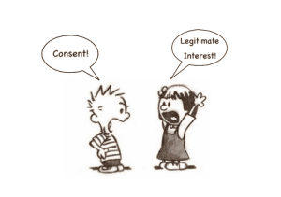
GDPR in a Nutshell – 2/2
User consent
Data Protection Officers (DPO)
Notification of security breaches
Enforcement scope
European Data Protection Board
Concepts of “pseudonomysed” data and privacy seal (“EuroPriSe")
Image credits: https://www.peerlyst.com/posts/gdpr-getting-to-the-lawful-basis-for-processing-david-froud
Notes:
6. Higher threshold for consent meaning there will only be limited circumstances when it may be relied upon.
7. New requirement to appoint a DPO in certain circumstances such as when processing volumes of “special categories” of data. The DPO must be independent and must not be instructed on how to carry out his or her role. The DPO must report directly to the highest level of management. DPO functions can be outsourced, for example to a law firm or consultant. If a DPO is a practising lawyer their advice will also be protected by privilege.
8. Data subjects to be notified when there is a high risk to rights and freedoms. All security breaches to be notified to the Information Commissioner within 72 hours, where feasible.
9. GDPR applies to non EU companies targeting goods and services at EU citizens. The mechanism for compliant transfers of data outside the EEA is largely unchanged. There is also formal recognition of binding corporate rules and a replacement of the ‘Safe Harbor’ arrangement with the US.
10. European Data Protection Board to replace Working Party 29 with remit for guidance and consistent application of the GDPR.
11. “Pseudonymised” data formally recognised as a security protection. New concept of data privacy seals.

Slide 12
Data Subjects rights
The GDPR does provide data subjects with a set of rights over the administration and use of their personal data
Organizations that control personal-data processing activities throughout the data life cycle should have less trouble enabling these rights
The right to data portability could be assured by implementing a self-service portal; the same online platform can be used to provide transparency and notification
The right "not to be subject to a decision based solely on automated processing, including profiling" implies a strong focus on automation of analytics and the use of the subsequent results
Notes:
Should we prepare for data subjects to exercise their rights? Yes.
The GDPR does provide data subjects with a set of rights over the administration and use of their personal data, though some of these rights already exist.
GDPR Articles 12 through 23 deal with the rights of data subjects; this research highlights a few such rights.
Organizations that control their personal-data processing activities throughout the data life cycle should have less trouble enabling these rights. The "right to be forgotten," for example, mainly follows the retention scheme. In the example of the car purchase, there is a valid reason to retain the customer's personal data as long as the payment plan hasn't ended. Note that, at the end of the determined data life cycle, the responsibility to control deletion of personal data extends to both the backup and the data processor's environments.
The right to data portability can be assured by implementing a self-service portal. This also enables other rights, such as the right to access what personal data is processed, or the right to correct or amend it. When established, the same online platform can be used to provide transparency (statements and notices), and notification. Where an assessment shows that a subject's rights requests are expected to be few and far between, a manual process to hand over the personal data will suffice.
Considering the evolution of the Internet of Things (IoT), (big) data analytics and increasing application of machine learning and artificial intelligence technology, Article 22 provides an interesting right: The right "not to be subject to a decision based solely on automated processing, including profiling." Barring the exceptions provided in that same article, this implies a strong focus on automation of analytics and the use of the subsequent results. Analytics activities used for "what advertising do we show on a website," for example, will likely not have a high impact; but in other use cases, such as determining whether someone gets a mortgage, credit card or job, caution is advised.

Slide 13
Data Subject consent
It should be freely given, there can be no coercion or pressure
Consider employee relations
"Consent" in the GDPR requires several conditions:
"By a clear affirmative act"
"Specific“
"(As an) informed and unambiguous indication of the data subject's agreement to the processing of personal data“
The burden of proof that consent was obtained lies with the data controller
Notes:
Is there anything special about consent? Yes.
The characteristics of consent are quite specific. For one, it should be freely given, indicating that there can be no coercion or pressure. This brings a complication in, for example, employee relations, where an employee might be afraid to lose his job when not consenting to a specific processing activity. Employers should therefore tread carefully when relying solely on that basis.
"Consent" in the GDPR requires several conditions:
"By a clear affirmative act." Silence or implied consent and pre-checked boxes, then, are a thing of the past. The organization must ask outright for consent.
"Specific." When the processing has multiple purposes, consent should be given for all of them. Obtaining separate consent is advised where the processing activities are not inherently related. Buying a pair of sunglasses in a web shop, for example, does not automatically lead to receipt of the daily newsletter from that moment on. The burden of proof — that consent was indeed obtained in a correct and explicit manner — lies with the data controller.
"(As an) informed and unambiguous indication of the data subject's agreement to the processing of personal data." For consent to be informed, the identity of the controller and the processing purposes should be provided. This requires use of plain language when providing the information the consent is based on. Likewise, member states have additional requirements for the protection of children (minors), as their consent may not be deemed valid.
Finally, the burden of proof that consent was obtained lies with the data controller. Thus, proper consent management includes not only administration (logging) of the consent itself, but also the conditions under which it was provided.

Slide 14
Recap: DC vs DP
Data Controller | Data Processor
Controls what personal data is processed | Uses data only as instructed by Data Controller
Responsible for the processing purpose (e.g. determines why that personal data is processed) | Processes data as instructed by the Data Controller
Responsible for the means of processing by the Data Processor | Must respect the contractual agreement with the Data Controller
May create third-party agreements with Data Processors and sub-Processors | May create sub-Processor agreements as authorised by the Data Controller
Data Processor = Third-Party
Notes:
The "means" of processing may include any third-party service provision. Few organizations perform 100% of data processing themselves. Any third party involved in processing of personal data on behalf of the data controller functions as a "data processor." This then includes an outsourced complaint-handling call center, cloud-hosting provider, or any as-a-service third party.
Data controllers must acknowledge the risk involved in where a data processor is deployed (for example, a SaaS, infrastructure as a service [IaaS] or identity and access management as a service [IDaaS] provider), and prioritize the following:
Data processors should only use personal data as is instructed by the data controller. Noncompliance on the part of a data processor with regards to the data controller's instructions, or the GDPR itself, reflects on the data controller's reputation. Data controllers must therefore demand assurance via data processor agreements to ensure personal data is properly handled by the data processor.
"Subprocessing" takes into account the full data life cycle, and regards any other data (sub)processor in the chain. Data controllers should take this chain into consideration when selecting a third-party service provider and demand that the requirements of data processors are applied to subprocessors as well.
SRM leaders must revise the vendor selection must-have criteria, and add qualitative protection requirements via procurement in the vendor selection process. This enhances a data processor's "fit" with the overall data controller's risk appetite and privacy compliance requirements.

Slide 15
DC vs DP
Organizations should be aware that they can occupy both roles in different processing activities
Using a cloud-hosting provider's services, an organization may be a data controller and the hosting provider the data processor as it stores and processes the data on behalf of the data controller.
Conversely, when deploying EU-based employees, the cloud provider may be the controller for the HR activities.
Similarly, a marketing agency may be a B2B client's data processor in the initial service provision, but when it uses the data gained in contracts to enrich profiles for a campaign of its own, it is the data controller for the latter activity.
Notes:
Organizations should be aware that they can occupy both roles in different processing activities.
Using a cloud-hosting provider's services, an organization may be a data controller and the hosting provider the data processor as it stores and processes the data on behalf of the data controller.
However, when deploying EU-based employees, the cloud provider may be the controller for the HR activities. Similarly, a marketing agency may be a B2B client's data processor in the initial service provision, but when it uses the data gained in contracts to enrich profiles for a campaign of its own, it is the data controller for the latter activity.

Slide 16
Implementing a GDPR program
GDPR Implementation Basics

Slide 17
GDPR Personal Data Lifecycle
Collect + Classify
Process
Delete
Define the purposes of collection
Collect only the personal data necessary
Inform data subjects
Identify the categories and sensitivity of personal data
Process personal data lawfully, fairly and transparently
Facilitate the exercise of Data Subject rights
Do not keep personal data for longer than it is necessary
Upon lawful request, erase a data subject’s personal data without undue delay
Notify any processors of the erasure request
Secure
Share
Document
Implement technical and organizational measures to ensure a level of security appropriate to the risk based on the nature, scope, context and purposes of processing.
Only share personal data with processors that provide sufficient guarantees
Perform GDPR compliant cross-border data transfers
Maintain records of all processing activities covering the entire personal data lifecycle
Notes:
Collect
Define the purposes of collection and collect only the personal data necessary for the intended purposes. (Articles 5(1)(b)-(c))
Inform the data subjects about your company’s privacy policies and practices. (Articles 12-14)
Classify
Identify the categories and sensitivity level of the personal data that determines the handling requirements. (Articles 4, 9-10)
Process
Process personal data lawfully, fairly and transparently. (Articles 5-14)
Facilitate the exercise of data subject rights in relation to their personal data. (Articles 15-22)
Share
Only share personal data with processors that provide sufficient guarantees of technical and organizational measures that comply with GDPR. (Articles 28-29)
Perform only GDPR compliant cross-border data transfers. (Articles 44-48)
Delete
Do not keep personal data for longer than it is necessary. (Article 5(e))
Upon lawful request, erase a data subject’s personal data without undue delay. (Article 17)
Notify any processors of the erasure request.(Article 19)
Document
Maintain records of all processing activities covering the entire personal data lifecycle. (Article 30)

Slide 18
GDPR Gap Analysis How-To
Performing a risk assessment
data processing activities
each technical and organizational control
Developing a prioritized remediation roadmap
Implementing technical, organizational, policy, and process improvements
Documenting the overall control environment
strengths
weaknesses
intended future state
Notes:
In line with GDPR’s accountability principle, the artefacts from these processes must be detailed enough and retained to demonstrate your organization’s level of compliance and risk management efforts. Your risk register and remediation roadmap are used to demonstrate that the weaknesses in processes and technologies have been evaluated and prioritized, and the documentation of your control environment provides a comprehensive representation of your organization’s security program.
Performing a risk assessment in relation to your data processing activities, as well as each technical and organizational control with all required factors of GDPR in consideration (e.g. state of the art, costs, and nature of the data processed). As a result, creating a risk register recording all applicable risks from accidents and insider threats to malicious attacks.
Developing a prioritized remediation roadmap
Implementing technical, organizational, policy, and process improvements to progress along the remediation roadmap.
Documenting the overall control environment including strengths, weaknesses, and intended future state.

Slide 19
Basics of GDPR Implementation
Write a Privacy Notice and publish it
Inventory of processes and activities
Implement Data Retention
Implement Data Subject access rights and consent requests
B2C
HR
Procurement
Perform Data Protection Impact Assessment
Implement Security & Privacy by design / privacy by default
Handle personal data transfer & Third-Party management
Ensure Data Breach management process is in place
Notes:
Marketing department, GDPR implementation team
Each department, with the CDO, data office or GDPR team as coordinator. Small company can do it at company level
Ensure that DS can make access requests and that the consent is requested. Marketing for end customers/consumers, HR for employees, procurement for suppliers
As above
DPIA template to be prepared and distributed. Create a processing activity or change an existing one. GDPR implementation team
Review security policies and assess that they include privacy by design – IT, maybe lead by a CISO
Data transfers secured, contracts amended. Procurement and legal, plus business units representatives.
Data Breaches need to be identified, registered and reported as required – 72 hours for notification. Implement plan to minimize breaches. Incident Management team/SOC/NOC/etc.
Will we be fined for a data breach?
Not necessarily. Barring the absence of any processing activity, 100% security does not exist. Organizations should assume a data breach will happen. They are responsible, however, for the application of sufficient preventative, detective and other countermeasures. Though experiencing a data breach in itself is not sanctionable, it is the ultimate moment to demonstrate sufficient control over personal data.
A data breach (or "every unintended loss of [control over] personal data") must be communicated to the regulatory authority within 72 hours of detection. When the breach has a potential impact on the subjects, the organization should notify those individuals as well. A subsequent investigation, or even the lack of notification, may reveal noncompliance, which in turn can be reason for regulatory action.

Slide 20
Art. 30, “Records of Processing Activities” – 1/2
Art. 30 is the foundation for all compliance activities
Opportunity to leverage information being collected to enable “flags” which indicates high-risk business processes
Use art. 30 to set up a system which is starting to document what is collected and from who is collected
Automate time consuming and timely processes (sending reminders, etc.)
Setup thresholds to identify where something triggers a Data Protection Impact Assessment (DPIA) – or not
Use this system to check cross-border data transfer points
Notes:
Automate time consuming and timely processes (sending reminders, etc.) – Art. 30 is the “go to” place. Foundation for all compliance activities, indicates which information needs to be collected here.
Opportunity to leverage information being collected to enable “flags” which indicates high-risk business processes
Use art. 30 to set up a system which is starting to document what is collected and from who is collected
Setup thresholds to identify where something triggers a Data Protection Impact Assessment (DPIA) – or not
Use this system to check cross-border data transfer points
Justify the collection of data, data retention, and identify where the right consent is given – legitimate business activity?
Setup reminder of when data needs to be “retired”
Build-in reporting for external vendors – interactive technology, trigger questionnaires, etc.
Make it simple for the Data Subject – single point of contact, single front-end process (e.g. self-service portal), standard templates (informative and standard), backend processes codified and standardised. Interaction should be a positive experience and reflect positively on your company
Art. 30 – Records of processing activities
Each controller and, where applicable, the controller’s representative, shall maintain a record of processing activities under its responsibility. That record shall contain all of the following information:
the name and contact details of the controller and, where applicable, the joint controller, the controller’s representative and the data protection officer;
the purposes of the processing;
a description of the categories of data subjects and of the categories of personal data;
the categories of recipients to whom the personal data have been or will be disclosed including recipients in third countries or international organisations;
where applicable, transfers of personal data to a third country or an international organisation, including the identification of that third country or international organisation and, in the case of transfers referred to in the second subparagraph of Article 49(1), the documentation of suitable safeguards;
where possible, the envisaged time limits for erasure of the different categories of data;
where possible, a general description of the technical and organisational security measures referred to in Article 32(1).
Each processor and, where applicable, the processor’s representative shall maintain a record of all categories of processing activities carried out on behalf of a controller, containing:
the name and contact details of the processor or processors and of each controller on behalf of which the processor is acting, and, where applicable, of the controller’s or the processor’s representative, and the data protection officer;
the categories of processing carried out on behalf of each controller;
where applicable, transfers of personal data to a third country or an international organisation, including the identification of that third country or international organisation and, in the case of transfers referred to in the second subparagraph of Article 49(1), the documentation of suitable safeguards;
where possible, a general description of the technical and organisational security measures referred to in Article 32(1).
The records referred to in paragraphs 1 and 2 shall be in writing, including in electronic form.
The controller or the processor and, where applicable, the controller’s or the processor’s representative, shall make the record available to the supervisory authority on request.
The obligations referred to in paragraphs 1 and 2 shall not apply to an enterprise or an organisation employing fewer than 250 persons unless the processing it carries out is likely to result in a risk to the rights and freedoms of data subjects, the processing is not occasional, or the processing includes special categories of data as referred to in Article 9(1) or personal data relating to criminal convictions and offences referred to in Article 10.

Slide 21
Art. 30, “Records of Processing Activities” – 2/2
Justify the collection of data, data retention, and identify where the right consent is given – legitimate business activity?
Setup reminder of when data needs to be “retired”
Build-in reporting for external vendors – interactive technology, trigger questionnaires, etc.
Make it simple for the Data Subject
single point of contact and front-end process (self-service portal)
standard templates (informative and standard)
backend processes codified and standardised
Interaction as a positive experience, reflect the company positively
Notes:
Automate time consuming and timely processes (sending reminders, etc.) – Art. 30 is the “go to” place. Foundation for all compliance activities, indicates which information needs to be collected here.
Opportunity to leverage information being collected to enable “flags” which indicates high-risk business processes
Use art. 30 to set up a system which is starting to document what is collected and from who is collected
Setup thresholds to identify where something triggers a Data Protection Impact Assessment (DPIA) – or not
Use this system to check cross-border data transfer points
Justify the collection of data, data retention, and identify where the right consent is given – legitimate business activity?
Setup reminder of when data needs to be “retired”
Build-in reporting for external vendors – interactive technology, trigger questionnaires, etc.
Make it simple for the Data Subject – single point of contact, single front-end process (e.g. self-service portal), standard templates (informative and standard), backend processes codified and standardised. Interaction should be a positive experience and reflect positively on your company
Art. 30 – Records of processing activities
Each controller and, where applicable, the controller’s representative, shall maintain a record of processing activities under its responsibility. That record shall contain all of the following information:
the name and contact details of the controller and, where applicable, the joint controller, the controller’s representative and the data protection officer;
the purposes of the processing;
a description of the categories of data subjects and of the categories of personal data;
the categories of recipients to whom the personal data have been or will be disclosed including recipients in third countries or international organisations;
where applicable, transfers of personal data to a third country or an international organisation, including the identification of that third country or international organisation and, in the case of transfers referred to in the second subparagraph of Article 49(1), the documentation of suitable safeguards;
where possible, the envisaged time limits for erasure of the different categories of data;
where possible, a general description of the technical and organisational security measures referred to in Article 32(1).
Each processor and, where applicable, the processor’s representative shall maintain a record of all categories of processing activities carried out on behalf of a controller, containing:
the name and contact details of the processor or processors and of each controller on behalf of which the processor is acting, and, where applicable, of the controller’s or the processor’s representative, and the data protection officer;
the categories of processing carried out on behalf of each controller;
where applicable, transfers of personal data to a third country or an international organisation, including the identification of that third country or international organisation and, in the case of transfers referred to in the second subparagraph of Article 49(1), the documentation of suitable safeguards;
where possible, a general description of the technical and organisational security measures referred to in Article 32(1).
The records referred to in paragraphs 1 and 2 shall be in writing, including in electronic form.
The controller or the processor and, where applicable, the controller’s or the processor’s representative, shall make the record available to the supervisory authority on request.
The obligations referred to in paragraphs 1 and 2 shall not apply to an enterprise or an organisation employing fewer than 250 persons unless the processing it carries out is likely to result in a risk to the rights and freedoms of data subjects, the processing is not occasional, or the processing includes special categories of data as referred to in Article 9(1) or personal data relating to criminal convictions and offences referred to in Article 10.

Slide 22
Information is the new gold
Information is an asset
Like software and hardware assets, build an inventory
Information is fluid
Include data flow diagrams
Answer these questions & document the answers
What data do we have?
How and why do we collect it?
What do we do with it?
Where do we store it?
How do we secure it?
Who do we share it with?
How long do we retain it?
What do we do with it at end of life?
Notes:
Leads to an understanding of your information lifecycle and custodial responsibilities along the way.

Slide 23
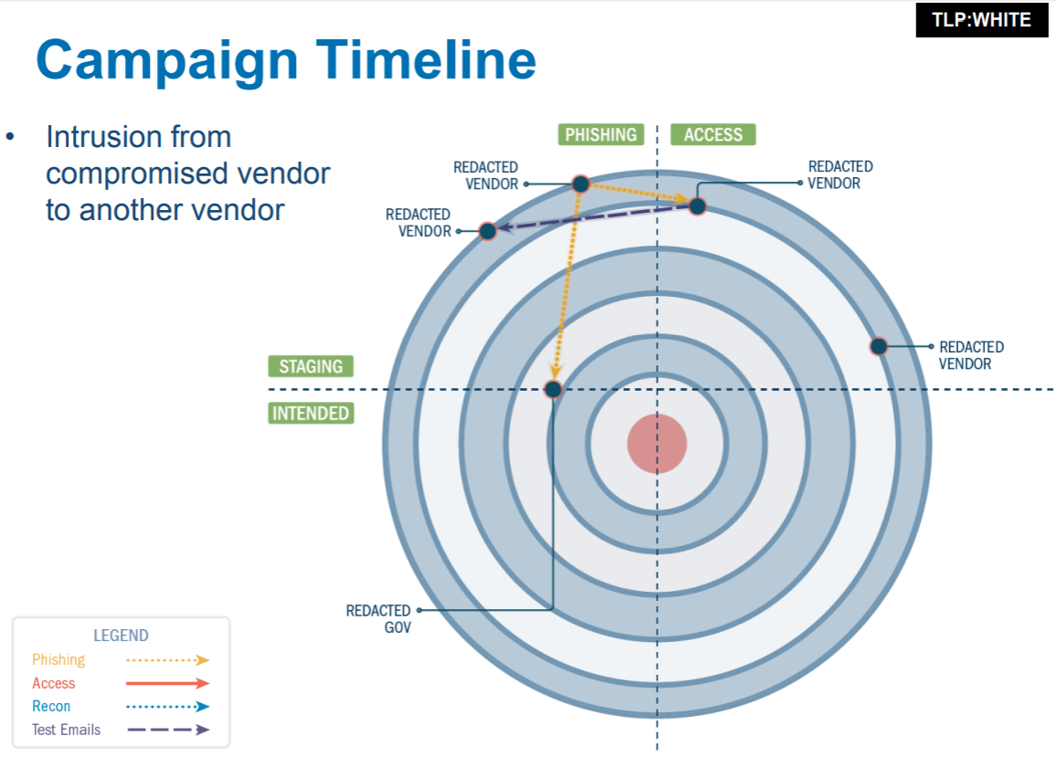
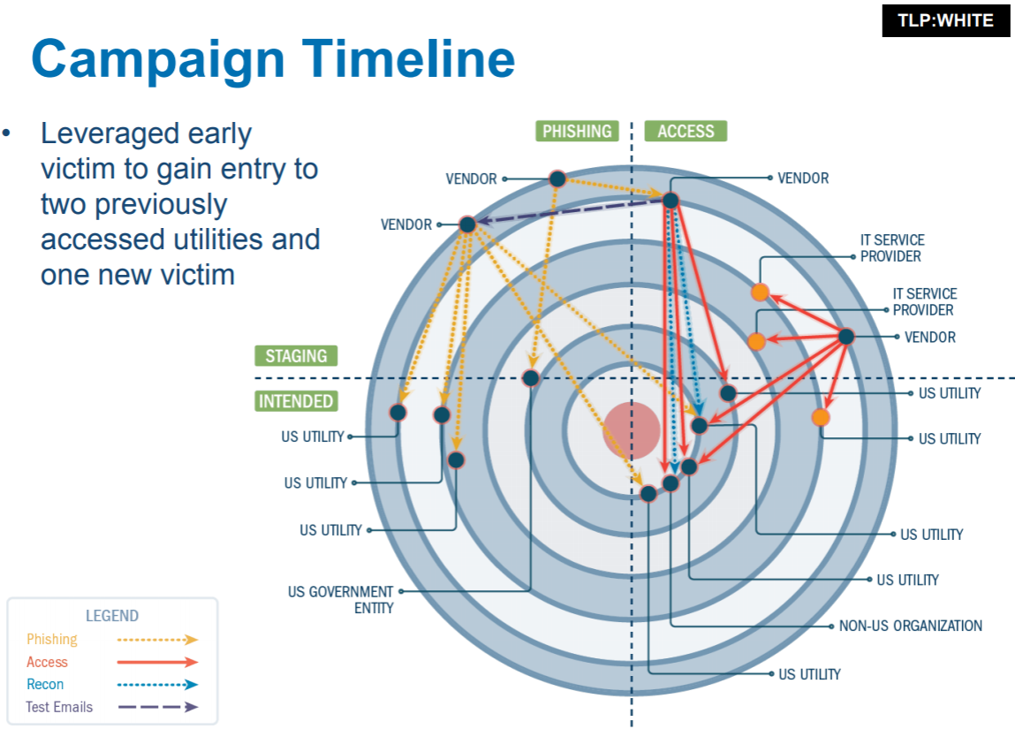
Third-Party vs Critical Infrastructure
Source: Awareness Briefings on Russian Government Activity against Critical Infrastructure
Notes:
Source: https://www.sccyber.org/news/409580/Awareness-Briefings-Russian-Government-Activity-against-Critical-Infrastructure.htm
Vendor compromised in early 2016, remained dormant for over one year
Additional vendor network compromised in early 2017
Phishing attack originating from compromised network against another vendor and government entity
Used new victim network to pivot and browse external content of an already - phished organization, as well as a non -U.S. organization
Used initial compromised vendor to access several U.S. energy utilities and IT service providers
Leveraged early victim to gain entry to two previously accessed utilities and one new victim

Slide 24
Lessons learned
Attackers are patient (instances of laying in wait for over a year)
Attackers know not to walk in the digital front door, preferring to hit weak vendors
Pivoting is not confined to just a company, pivoting across companies is very real
“Secure” vendors are not as secure as they want us to think
When vendors brag about having certain companies as clients, they open themselves up as targets
External firms are being used as staging and exfiltration points
Moving between traditional IT and ICS/SCADA is relatively simple today

Slide 25
Third-party and GDPR
Many organizations outsource processing of personal data with third-party service providers
Very little control over data, increased risk of noncompliance
Security posture is rarely an evaluation criterion
Recommendations
Specify vendor-selection criteria
Add requirements as exclusion/inclusion criterion in procurement
Ensure adherence to the requirements throughout the lifetime of the contract by leveraging one or more assurance methods as described
Notes:
Key Challenges
Many organizations outsource processing of personal data on employees or customers with third-party service providers. They have very little control over this data, thereby increasing risk of noncompliance.
An organization's ability to ensure adequate protection and legal usage of the data is rarely an evaluation criterion in the vendor selection process and the subsequent contract period.
Recommendations - Security and risk management leaders focusing on the privacy management program in relation to third-party selection and control should:
Specify vendor-selection criteria by extracting minimum requirements from existing policies.
Instruct managing staff to use the requirements by adding them as exclusion/inclusion criterion in procurement activities.
Ensure adherence to the requirements throughout the lifetime of the contract by leveraging one or more assurance methods as described in this research.
Source: Gartner - https://www.gartner.com/document/code/319944

Slide 26
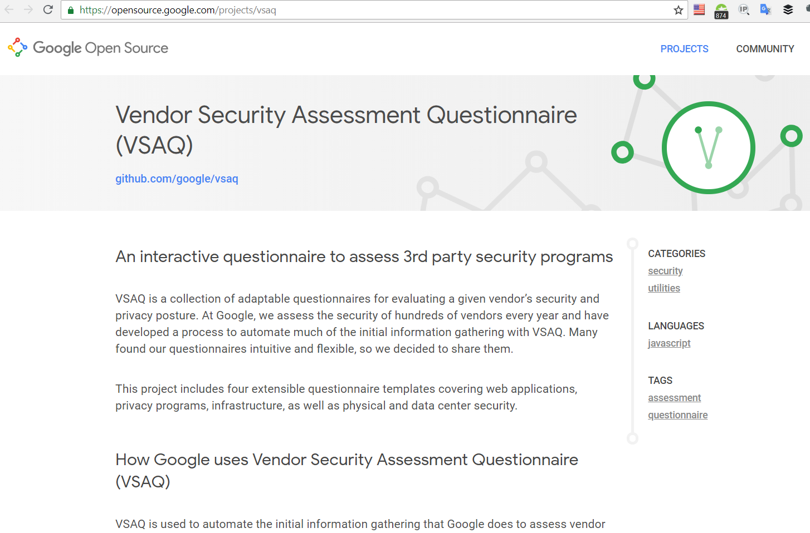
Google’s VSAQ
Source: Google VSAQ
Notes:
https://opensource.google.com/projects/vsaq
Security and Privacy are together

Slide 27
Minimize third-party and internal risks
Use automation for vendor management
Reduce the amount of work. Look for control that meets the purpose, they meet controls and documentation level that you expect for your own internal level
Teeth in the contracts, periodic review
Breach due to vendor? Data exposed? Show that due diligence was done, appropriate controls where in place and additional security practices where instantiated to protect to the best level of ability and appropriate to the level of sensitivity
Diversified data stores – pulling data from different IT security applications, everything you said you will do is done, if not, create a gap analysis and remediation plan. Visibility is the key.
Notes:
Vendor management: automation, validating they are holding their end of the bar
Security Assessment Questionnaire helps you scale and automate risk assessments of your third parties and internal teams, as required by GDPR.
Intuitive survey design and pre-built templates, including GDPR-specific resources
Simplified questionnaire distribution
Automated campaign tracking and response monitoring
Centralized data aggregation and report generation

Slide 28
Supplier’s Management – ISO 27001
control A.8.1.4
control A.9.2.6
clause 6.1.2
control A.7.1.1
control A.15.1.2
control A.9.4.1
control A.15.2.1
Risk Assessment
Screening / Auditing
Selecting clauses in the agreement
Access control
Compliance monitoring
Termination of the agreement

Slide 29
Cybersecurity and GDPR for M&A
Why M&A need Cyber Security support?
What is the impact from the GDPR?
What value does a security professional bring to the team?
Notes:
Why M&A need Cyber Security support?
Aren’t they just ordinary business transactions?
They seem to occur nearly every day, so what is so special about them that they require special security support, or any security support at all?
What value does a security professional bring to the team?

Slide 30
Business Drivers
Confidentiality
Speed
Business as usual
Zero Impact
Informed Business Decision on Risk

Slide 31
M&A Threats
Special Interest Groups – gain from the Operation
Financial Criminals
Competitors
Acquisition / Merger Company
Disgruntled Employees
General Interest Groups – gain from Impact
Script Kiddies / Hackers
Hacktivists / Terrorists
Spies

Slide 32

This used to be the only threat…
Notes:
High profile data breaches, combined with pending data privacy regulations which put higher financial penalties on data breaches, such as the GDPR, will result in the scope of M&A due diligence being significantly widened to cover not just the usual legal, financial, commercial, environmental and HR aspects, but also to create a new ‘digital due diligence’ or ‘cyber security due diligence’. The adoption of the GDPR will play a crucial role in enforcing cyber security to a standardised level across the EU.

Slide 33
Introspection moment
Publicity, raising profile — your interest gets attacker’s interest!
Impact on:
Resources
Technologies
Infrastructure
Disgruntled Employees
Change in threat and risk model
Absorbing unknown / confusion
Creating new attack vectors and window of opportunity
Business drivers force the hand of the Security Manager very quickly
Are we all really equipped for change?
Notes:
One of the few times an Organization is really “shaken up”

Slide 34
GDPR driving changes in M&A
Significant behavioural change in acquirers
Embed GDPR considerations in technology due diligence
Failing to do this brings significant transaction risks
Gap Analysis for GDPR readiness
Key areas: due diligence and post-merger integration
Notes:
Companies involved in M&A need to take account of whether the goods and services that either side supplies are available to residents of the European Economic Area (EEA) for purchase.
Through GDPR, companies are forced to review the way data is processed, establish procedures for protecting data, including the ability to report on data breaches, while also ensuring associated legal requirements are adhered to when protecting personal data. This has resulted in companies adapting their approach to M&A activity by tailoring their due diligence processes to include the principles set out by the GDPR.
The GDPR will drive a significant behavioural change in acquirers.
It is now commonplace for an acquirer to embed GDPR considerations within a technology due diligence scope, to help inform a view on a target’s roadmap to compliance and the identification of associated risks. For example, cyber security flaws not identified until after a transaction can have a material financial impact, either through additional investment required to remediate risks, or through fines being enforced by regulators through the GDPR due to the loss of customer, employee, supplier or other sensitive data.
Companies that do not adopt a thorough approach to achieving compliance and implement effective procedures for dealing with cyber security breaches could hold a significant risk within a transaction, which could also lead to substantial fines being imposed.
With the GDPR, there has also been an increasing focus on privacy compliance in company due diligence, both on the buyer and seller side. Lack of documentation of compliance with key privacy requirements may lead to a lower valuation of the company if the buyer perceives that there is a privacy risk. An increasing number of sellers are taking into account the risks of privacy compliance by implementing a specific privacy vendor due diligence where the focus is to eliminate unnecessary non-compliance through which to increase the deal value.
It is critical for buyers to conduct a gap analysis to assess the target’s GDPR readiness so that they understand what work will be needed post completion to bring the company into compliance. Not only will the purchaser need to assess the risk of non-compliance, but also the cost of any changes, in particular, systems-based changes required. It is essential to understand the level of a target company’s GDPR compliance as this can have a material impact on the cost of the acquisition.
The key areas for M&A transactions will naturally be due diligence processes, as well as post-merger integration.
Source: https://svw.no/en/news/news/2017/december/gdpr-compliance--an-opportunity-for-adding-value-in-ma/
Source: https://www.nccgroup.trust/uk/our-research/manda-cyber-security-due-diligence/?research=Whitepapers

Slide 35
Due diligence – technical goals
Actual liabilities in terms of compliance
How divergent a target is from the buyer’s internal processes and standards
potential impact on the post-merger roadmap
Latent security issues in the product/service
reputational, operational, financial or legal impact
Identify risks in:
Compliance
Market
Technical assets including intellectual property
Operations
Integration
Notes:
These could be:
Actual liabilities in terms of compliance with, or adherence to standards or regulations.
Liabilities in terms of how divergent a target is from the acquirer’s internal processes and standards. Therefore what the potential impact will be on the post-close roadmap to integration.
Latent security issues in the product/service which might have a reputational, operational, financial or legal impact.
Compliance risks
Within any business, the level and type of cyber security-related compliance will vary depending on regions of operation, target markets, sector and whether any customer and/or staff data is held and processed.
Understanding cyber security-related compliance and any associated risk gives the acquirer the confidence that the target is not in contravention of any regulatory regimes or, if it is, that the exceptions are satisfactorily manageable.
Market risks
If a product makes claims, or is otherwise marketed based on its inherent security resilience or security functionality, the acquiring company must understand the possibilities or circumstances that would undermine this position.
Failure to adequately assess these risks could result in a devaluation of the brand, product or intellectual property, post-acquisition.
Technical assets including intellectual property
Technical assets and intellectual property can cover a broad range of things, including proprietary software, hardware and services that are sold to customers and even back-office IT functions and line of business applications.
Understanding any inherent security weaknesses, associated risks and likely future levels of investment required should be a key business consideration.
This understanding allows the acquirer to be aware of any short-term liabilities while also knowing what level of capital and operational expenditure will be required to bring it in-line with its own risk appetite.
The acquirer may also stipulate that certain improvements need to be made prior to deal completion if the risk presented is significant.
Operations
Operational security due diligence often builds on the understanding gained through the analysis of compliance, technical assets and intellectual property.
It does so by assessing people, policies, procedures, physical assets, suppliers and supply chains from a security perspective.
Identifying operational security risks and the costs to remediate allows the acquirer to build accurate investment plans as part of its post-close integration strategy.
As with technical asset and intellectual property assessments, in certain situations the acquirer may also stipulate that certain improvements need to be made prior to completion.
Integration
Integrating the newly acquired business into the acquirer’s environment can be a complex operation given the technical and operational risks associated with this type of activity. Understanding this risk and complexity allows for informed planning and investment decisions.
The result is that the integration will have tactical or strategic elements that minimise or bring in-line key identified risks within appropriate timeframes.
https://www.nccgroup.trust/uk/our-research/manda-cyber-security-due-diligence/?research=Whitepapers

Slide 36

Due diligence risk assessment
“Privacy risk”
Much more comprehensive
How target collects, stores, uses and transfers personal data
Historical data breaches
Include data processing in NDAs
QUIZ time!
Buyer
Target
Data Controller
Data Processor
Notes:
If you are the buyer, you will want assurances that the target has taken appropriate steps to protect confidential information from breaches and has considered upcoming data privacy regulations, such as the GDPR. You will also need to conduct cyber security risk assessments of the target. Targets will need to consider cyber security as part of any vendor due diligence process.
Privacy risk needs to be one of the core factors involved in the M&A process. That should really have always been a consideration, but as with many other processes, data governance and privacy has not always had the focus that it should, but it will definitely be important to manage that process.
Acquirers will need to engage in a much more comprehensive due diligence process to fully assess a target’s ability to comply with the GDPR.
Understanding how a target collects, stores, uses and transfers personal data,
as well as the details of any historical data breaches, will be vital in understanding the valuation and risks associated with a transaction.
Initially we will likely just see more data processing clauses in non-disclosure agreements (NDAs).
QUIZ Time: who is the data controller?
Potential acquirers are Data Controllers of the information they receive as part of the sales process, as they use that data for their own purposes. As such, they should, in line with an NDA, only use the data to evaluate the transaction, and in compliance with the law. If the data is exported, controller to controller, model clauses should be used. As is standard practice today, personal data in data rooms should be excluded or limited to the greatest extent possible.

Slide 37
How Due Diligence looks for real
Notes:
How Due Diligence looks for real
If you are part of the deal’s team
Use of a software from a third party firm (e.g. Deloitte D-Rooms)
Asset inventory and technologies used are derived from end-of-year taxes’ books (inventory and depreciation)

Slide 38
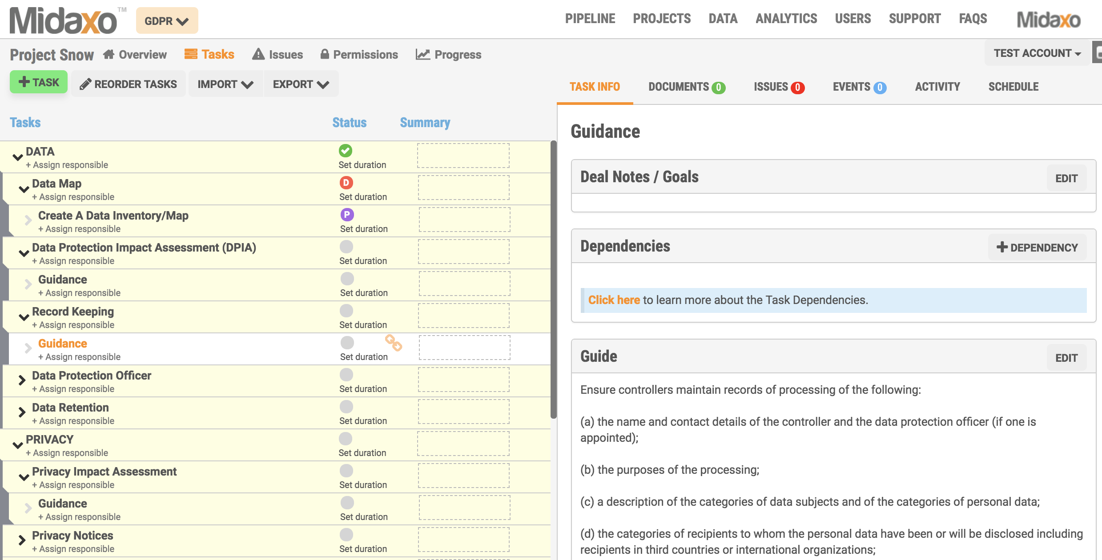
Virtual Data Rooms
Notes:
Embed GDPR considerations within a technology due diligence scope
Practically, security compliance must extend to the virtual data room or another central deal-management application. Sellers will want to limit specific detail provided within initial outreach and control proprietary information access. Buyers must ensure sufficient protocol and protection measures are in place within their deal room environments. Expected features to support compliance would include document permissioning, restricted functionality and the ability to audit the steps taken towards GDPR compliance.

Slide 39
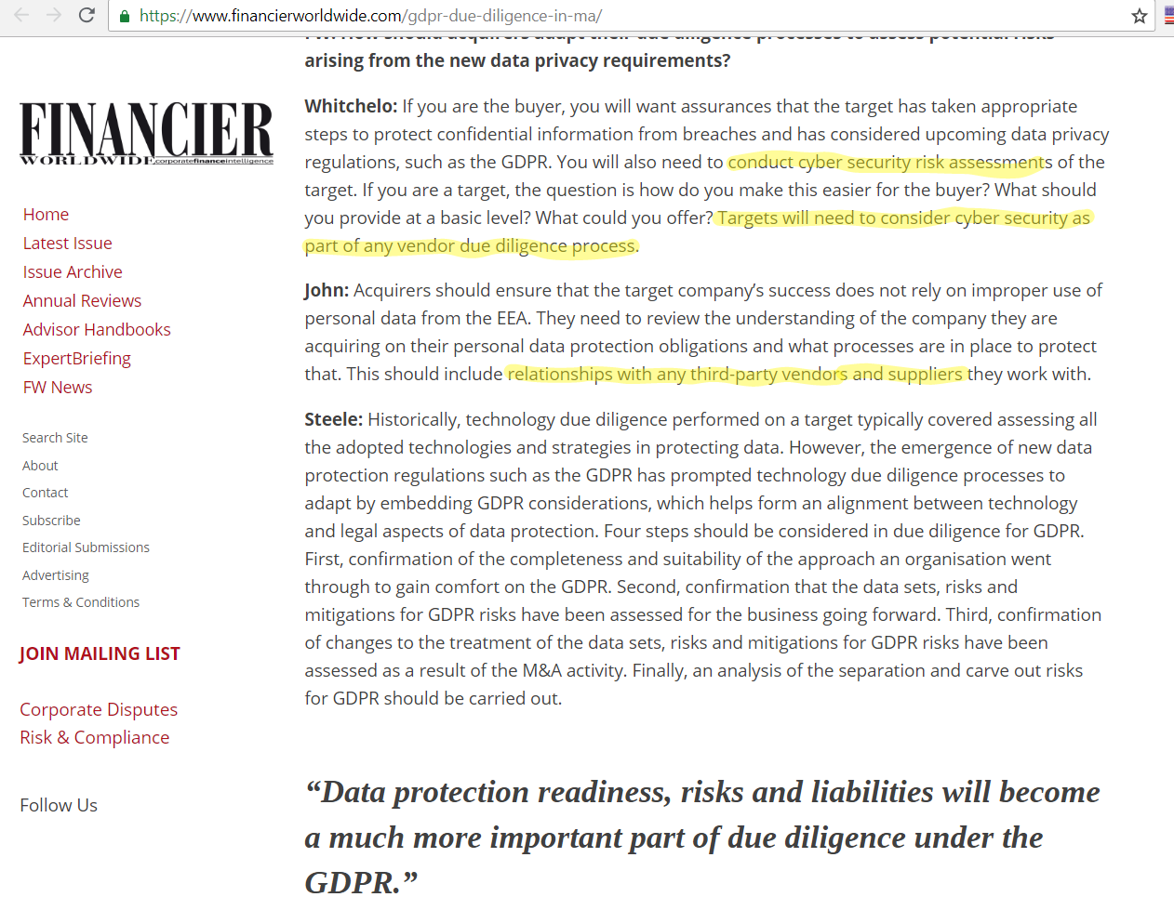
M&A experts on GDPR and Cybersecurity
Notes:
Source: https://www.financierworldwide.com/gdpr-due-diligence-in-ma/

Slide 40
Engage cybersecurity risks for GDPR in M&A
Engage cybersecurity experts
New questions
How is cyber-diligence conducted?
Specialist service providers?
What do we need to be aware of?
Has the business enough technical knowledge?
Notes:
To combat the threats to M&A processes from cyber security-related issues, acquirers will seek to engage external and internal cyber security experts to provide them with peace of mind and reassurance, and to evaluate the target’s cyber security measures as part of the due diligence process.
It is also clear that the GDPR and cyber security go together. Both will lead to changes in the due diligence process as the protection of data used in the process will become a critical issue, with the potential to derail a deal if certain criteria are not met or specific safeguards are not put in place.
This raises a lot of new questions.
How does one conduct cyber security due diligence?
Are new specialist service providers emerging?
What do advisers and corporate development teams need to be aware of as cyber security attracts more scrutiny?
Does the business have the sufficient technical knowledge and experience to remain compliant?
As a buyer, how do I gain assurances that my target has taken appropriate steps to protect its information?
As a target, what should I offer as part of the due diligence process, and how do I make it as painless as possible for the buyer?

Slide 41
Four Steps for Due Diligence
Completeness and suitability of the approach of target
Data sets, risks and mitigations for GDPR risks have been assessed
Changes to the treatment of the data sets, risks and mitigations for GDPR risks have been assessed as a result of the M&A activity
Analysis of the separation and carve out risks for GDPR
Notes:
Four steps should be considered in due diligence for GDPR.
First, confirmation of the completeness and suitability of the approach an organisation went through to gain comfort on the GDPR.
Second, confirmation that the data sets, risks and mitigations for GDPR risks have been assessed for the business going forward.
Third, confirmation of changes to the treatment of the data sets, risks and mitigations for GDPR risks have been assessed as a result of the M&A activity.
Finally, an analysis of the separation and carve out risks for GDPR should be carried out.

Slide 42
Post-Merger activities – Basics
Capture
Connect
Combine
Consolidate
Notes:
Capture. This process is ubiquitous to all deals. During the capture process, ITSEC collects information on assets, people, budget, and strategy from both internal functions and the Target to evaluate security and risk profile. Internally, information on the strategic intent of the deal is provided to the ATEAM. Other information includes facilities disposition, product plans, and organizational plans; this information aids in overall security planning.
Connect establish connectivity for the initial core infrastructure, setting up primary communication and collaboration tools and systems. This stage typically involves an interim step of creating a VPN tunnel, followed as quickly as reasonable by LAN/WAN interconnection, and then integration of other core IT infrastructure services. The connectivity can follow different steps, depending on the complexity and size of Target. The first focus is on immediate connectivity.
Combine: Integrate business systems and processes.
Consolidate: Realize economies of scale through organizational asset consolidation.

Slide 43
Post-Merger activities – GDPR specifics
Address consent from existing Data Subjects
Security Transformation Program
Manage risk in the short/medium term while satisfying compliance
Ensure detect and respond strategy for cyber security incidents
Technical Security consulting in cyber security
Notes:
The post-merger integration process will also need to address how existing consent from data subjects will affect the integration and future business goals of the combined entities, to allow for different uses of the data after deal completion.
Security Transformation: Strategic programmes of work to transform and/or integrate the acquisition.
Risk Management & Governance: Expertise in managing risk in the short to medium term while satisfying compliance issues.
Cyber Defence Operations: Ensuring the newly acquired entity is able to detect and respond to cyber security incidents.
Technical Security Consulting: Deep technical expertise in all elements of technical cyber security.

Slide 44
The Role of the Cybersecurity Expert
Protecting the effort itself
Confidentiality of the total effort
Confidentiality of the team’s work
Evaluating the security condition of the target company
Impact on the deal’s value – GDPR into play
Asking the right questions
Providing subject matter expertise
Identify Security Requirements for the New Company
Controlling Rumors
Managing Global/International Aspects
“Team Consultant”
Low Hanging Fruits
Notes:
Protecting the effort itself: Security measures are applied to the merger or acquisition effort to ensure that it is properly protected. That includes the implementation of measures to protect the confidentiality of the effort and its people, information, and physical assets.
Confidentiality of the total effort: For competitive reasons, it may be necessary to keep the existence of the effort unknown to all but the merger or acquisition team itself.
At some point in time, all mergers and acquisitions become known, but that occurrence must be controlled, deliberate, and approved by executive management. It must not be accidental or happenstance.
Confidentiality of the team’s work must be maintained: Specific strategies, plans, processes, analysis, and assessments must not be revealed to people outside the team without the expressed permission of team leadership, or another in the executive management chain. Unauthorized releases may compromise or harm the effort.
An unauthorized release of information may allow a competitor to gain information of value at little or no cost to itself.
Evaluating the security condition of the target company: The security manager is charged with assessing the security condition of the target company. Ideally, the security manager conducts a security audit of the target company’s security program and overall security condition, which becomes part of the total team’s assessment. Any issues identified are given consideration in terms of their effect on closing the deal. Unless severe security problems exist, security issues generally never break the merger or acquisition (deal). However, security problems or a substandard company security program can impact the value of the deal. Anything that may affect the value of the deal must be given serious consideration. Failure to do so is something less than a proper due-diligence effort.
Providing subject matter expertise: The security manager or professional serves as a member of the team and provides guidance, direction, and consultation on all security-related issues and concerns.
Identify Security Requirements for the New Company
The combination of two companies into a single larger company changes that company in many ways. Those changes should be anticipated and evaluated in terms of future security requirements.
Some of the security needs of the newly created company may be driven by the security condition of the two companies coming together.
Any security problems or vulnerabilities identified during the assessment phase will require attention during the integration phase. Understanding the impact of security problems and vulnerabilities early on will allow more time for planning and development of mitigation measures.
In some cases when two companies come together, it may not be practical to simply impose the security practices of the acquiring company on the new company. The structure and operations of the new company may be so different from either heritage company that the overall security needs and requirements for the newly combined company may now differ significantly. If this is the case, much work will be needed in assessing and understanding those needs and developing procedures and practices to support them.
Controlling Rumors
Preventing rumors is impossible. Limiting and controlling them are possible. Frequent, open, structured, honest, and planned communications will cut down on the development and spreading of rumors.
Global/International Aspects
If the merger or acquisition effort involves companies from different countries, the role of security becomes more involved and demanding. International travel, laws, and regulations from multiple countries and cultural and language differences along with differing business practices make the task of protecting the effort, people, and information more complicated. Having an understanding of international business issues will be helpful. Having a security manager on the team with experience in international business, and security will be invaluable to the effort. When an acquisition team leader selects a security manager to support the team, the leader should keep in mind the importance of international business experience.
Team Consultant: Part of the role for security is to serve as the team’s “in-house consultant,” that is to say, serve as a subject matter expert and help the team learn as much as possible about the target company, particularly as it pertains to matters of security.

Slide 45
The Cybersecurity Expert in action
Preliminary background investigations
Collection of Open-Source information
Due diligence
More in-depth look
Estimation of Costs of Cyber Security – GDPR impact!
Operations security – post-merger into focus
Protect operational activities
Develop and implement protective measures
Appropriate for each phase of the acquisition
Notes:
Preliminary background investigations: Learn as much as possible about the target company and its leadership. All knowledge gained early will have value in later phases. The more the merger and acquisition team can learn about the target company the greater the possibility of good business decisions being made.
Due diligence: During the due diligence phase of the effort, the merger and acquisition team has an opportunity and an obligation to take a more in-depth look at the target company. This examination is still limited. How extensive it becomes may require an agreement by both companies. Nevertheless, it will be an opportunity to learn more about the target company than is available from open sources. The time frame for the due diligence is limited but should be sufficient to allow for obtaining enough information about the company so that when this information is combined with data gathered from other sources as well as open sources, chances of making the correct decisions are enhanced. It is during this phase that the team leadership identifies and considers all problems and concerns. The problems are evaluated and a decision is made to proceed with the merger or acquisition or abort the effort.
Cost of security: Within most companies, security is a cost center and not a revenue center. Unless the company is in the business of selling security products and services, security does not usually generate revenue. Like other supporting functions, the security organization exists to fulfill a protective and compliance role. Company assets protection, driven by laws, regulations, and the need to mitigate risks, are the reason security organizations are formed. Moreover, to protect their own interest, most companies establish a set of rules (policies and procedures) to provide a protective framework for employees to operate within. This costs money.
Operations security: Operations, or operational security (OPSEC), refers to the measures and controls applied to the effort to ensure that the day-to-day activities of the team are protected to the extent appropriate. The security manager is responsible for leading this effort and for developing and implementing the necessary protective measures. Protective measures vary with each phase of the effort, as each phase differs in its need for control. For example, the initial discussion concerning the team’s intentions to acquire a target company and the background assessments of that company and its executives generally need to occur under very tight controls. Preventing knowledge of the discussions from becoming public could have competitive and legal implications. For example, if publicly traded companies are involved, information suggesting the possibility of a merger or acquisition could have an impact on the stock price of one or both companies.

Slide 46
Combining the two companies
Resources, staffing, processes, and systems
Business processes
IT tools
Active Directory merging strategy is key!
The Target company has comparable / same security
Exceptions are documented and signed off by leadership
Agreed-upon designs
Operations turned to standard support
Weekly or recurring meetings
Notes:
Resources, staffing, processes, and systems are combined
Business processes are as much as possible leveled
IT tools are unified
Active Directory merging strategy is key!
The Target company has assumed a comparable or the same security posture as the acquiring company
Differences in processes and IT Security posture, as well as “misses” from the Integration Plan, are documented and signed off by key stakeholders (leadership, executives, CISO)
The agreed-upon designs are implemented, and
Operations — including Cyber Security – are turned over to standard support
Weekly or recurring meetings can be setup to assess integration phases are carried out as expected, and do follow IT Security best practices

Slide 47
IT/Cybersecurity Post-Mergers Objectives
Target Characteristics | Security Guidelines | SLAs
SMALL Small employee base (< 200 employees) Low complexity Private ownership Little to no geographical diversity No separate legal entities No/limited need to keep the same facilities No/limited to keep the existing technologies Purchased for limited product portfolio, technology, talent, or local presence | Baseline security controls Target is fully absorbed into IT infrastructure All IT labor is absorbed into IT global business units | Security controls established or confirmed in less than 100 days
MEDIUM Similar to previous kind, but Target has certain identifiable complexities that require specific sensitivity during integration Fewer than 500 employees Needs to be stand-alone for a certain period of time During stand-alone time, Target maintains defined non-compliances Supports its own IT infrastructure during the stand-alone phase | Integration of Target may be full, hybrid, or standalone All IT labor is absorbed into IT global business units | Operation integration of some IT infrastructure may take +180 days Processes may take 3 to 9 months
LARGE More than 500 employees Relatively large operations Significant multinational presence and subsidiaries Target contains certain identifiable complexities that require specific sensitivity during integration | Integration of Target may be full, hybrid, or standalone IT labor can stay funded by Target company | Operation integration of some IT infrastructure may take +180 days Customized integration plan IT Support is shared Processes take more than 12 months

Slide 48
Merging Policies
Safeguards against disgruntled employees
New employee contracts
Are existing Policies still relevant?
Are we “dumbing down” their security?
Existing employee contracts
Do they protect you?
Do they meet new relationship?
Identify key policies — yours vs theirs
Work with Legal Departments

Slide 49
Conclusions
Lack of privacy documentation can lower target’s value
Privacy by design and by default can have business fall behind
“Personal information is the new gold”
Strategy for cost-effective data protection =
Competitive advantage
Boost in value
Considered more secure trustworthy by customers
Emphasize valuation
Rewards in greater utilization of personal data
Potential reward: increase M&A deal value significantly
Notes:
With the GDPR, there has also been an increasing focus on privacy compliance in company due diligence, both on the buyer and seller side. Lack of documentation of compliance with key privacy requirements may lead to a lower valuation of the company if the buyer perceives that there is a privacy risk. An increasing number of sellers are taking into account the risks of privacy compliance by implementing a specific privacy vendor due diligence where the focus is to eliminate unnecessary non-compliance through which to increase the deal value.
Due to the increased focus on privacy caused by the GDPR, the deal value may not only be affected by personal data compliance or the lack of it. The privacy by design and by default requirements will force businesses to consider data protection during the initial phase when developing new products and services, rather than as an afterthought. Businesses that do not adhere to this change run the risk of falling behind.
If the target company has taken advantages of the opportunities offered by the data protection rules, this may increase the deal value. Many transactions are driven by the buyer's appetite for the value represented by the target company's possession of large quantities of valuable personal data and the idea that the buyer will be able to further capitalize on this value going forward.
Target companies with an outlined strategy with regard to personal data may be easier to value for potential buyers, as opposed to companies that lack such strategy and not are able to demonstrate the company's level of compliance. Buyers are also likely to appreciate that they will not have to implement a new privacy strategy and adequate legal framework post-closing of the transaction, which often is expensive, time consuming and challenging to implement successfully.
Companies generally should be able achieve competitive advantage by having outlined a strategy that focuses on making efficient and cost-effective data protection measures while at the same time being within the regulatory framework and customer expectations.
Such strategy will in general boost the value of the company.
We also believe that companies being accurate and strict in data processing and showing transparency towards their customers will be considered more secure and trustworthy players.
These factors are likely to be emphasized by potential buyers in the valuation of target companies.
The rewards for greater utilization of personal data are significant for companies with, inter alia, the increased number of online stores, the extended use of web portals with login options and online identifiers (cookies, etc.). Thus, this will not only be important with the emergence of artificial intelligence, blockchain and ICOs, but for all businesses collecting, using or processing customer information within both B2B and B2C.
Summing up, the message is that potential sellers who focus on dealing with data protection matters prior to an M&A transaction, are likely to increase the deal value significantly as it will reduce the risk for the buyer connected to potential fines and at the same time reduce the buyer's costs since no or only few adjustments must be made post-closing.
https://svw.no/en/news/news/2017/december/gdpr-compliance--an-opportunity-for-adding-value-in-ma/

Slide 50
GDPR has no specific guidance on Cloud
Using Cloud Services invokes a shared responsibility model
GDPR creates issues for organizations that process personal data in the Public Clouds
rights of data subjects
data residency
cross-border transfers
The level of support from cloud providers may not be known
Recommendations:
gap analysis
identify the organizational and technical actions required
ask all public cloud service providers to provide required certification or proof of adherence to a code of conduct
Notes:
Source: Gartner - https://www.gartner.com/document/3874573
General Data Protection Regulation (GDPR) is a very complex regulation, with no specific guidance on public cloud computing.
Using a Cloud Service Provider invokes a shared responsibility model for addressing the GDPR. A CSP must meet the minimum requirements for the GDPR without limiting or hindering compliance efforts.
GDPR creates issues for organizations that process personal data in the public cloud, with regard to the rights of data subjects, data residency and cross-border transfers of personal data.
Many organizations don't yet know what level of support their cloud providers that they work with can offer with regard to GDPR compliance.
Recommendations – to achieve GDPR-compliant utilization of public cloud computing strategies, enterprise architecture and technology innovation leaders should:
Perform a gap analysis between the current policies for data subjects, controllers and processors, as well as cross-border transfer and data residency, against the requirements specified in the GDPR.
Identify the organizational and technical actions required for achieving GDPR compliance, such as adapting workloads at different stages of the cloud journey, revising security policies and checking data residency requirements.
Ask all public cloud service providers that they're working with to provide required certification or proof of adherence to a code of conduct.

Slide 51
Helpful Cloud tools
A Data Controller is responsible for the conduct of any of its Data Processors – even if they are Cloud Providers
Noncompliance with regard to GDPR on the vendor side reflects on the compliance of the end-user organization
Moving to the cloud may add to the security aspects of the processing activity, but could also lead to residency concerns
CASB service may be helpful
Data protection in hybrid or on-premises operations is increased by adoption of DCAP products
Privacy compliance is demonstrated by mapping, dashboarding and logical control application
Notes:
Source: Gartner
How does cloud technology relate to the GDPR?
A data controller is responsible for the conduct of any of its data processors. Noncompliance with regard to GDPR on the vendor side reflects on the compliance of the end-user organization. There are ways to retain control from an end-user perspective, and service providers are encouraged to adjust their products equally. Moving to the cloud may add to the security aspects of the processing activity, but could also lead to residency concerns. If the risk appetite of the end-user organization requires additional controls, a CASB service may be helpful. Alternatively, data protection in hybrid or on-premises operations is increased by adoption of DCAP products. These products monitor and respond to malicious or inappropriate user access behaviour with data stored pervasively across on-premises or cloud silos. A collateral benefit is that privacy compliance is demonstrated by mapping, dashboarding and logical control application.

Slide 52
Cloud IaaS and GDPR
IaaS cannot make a company GDPR-compliant, but can help
On their own, Clouds’ behaviour and tools will be insufficient
Google and Microsoft have specific awareness of user-generated personal data
AWS currently offers this in a limited way with Amazon Macie
Recommendations
Perform a DPIA when selecting a Cloud Provider
Perform a DPIA for each business process using a Cloud Provider
Use Cloud-provided tools when the risk assessment identifies that they can adequately address that part of the GDPR problem
Notes:
IaaS cloud providers cannot make an organization GDPR-compliant. However, they can help enable organizations to operate in a GDPR-compliant manner. Using a CSP invokes a shared responsibility model for addressing the GDPR. A CSP must meet the minimum requirements for the GDPR without limiting or hindering compliance efforts.
On their own, CSP behaviour and tools will be insufficient to meet all GDPR compliance requirements.
AWS, Google and Microsoft are all committed to addressing the GDPR, albeit in different ways. Google and Microsoft have specific awareness of user-generated personal data that was borne out of their provision of relevant controls within their G Suite and Office 365 SaaS offerings, respectively. AWS currently offers this in a limited way with Amazon Macie.
Recommendations - Technical professionals responsible for evaluating cloud providers for processing data in scope of the GDPR should:
Perform a data protection impact assessment (DPIA) when selecting a CSP for use in new scenarios where personal data is in scope for processing. The DPIA includes the CSPs commitment to service delivery behaviour and available tools for addressing the GDPR.
Perform a DPIA for each business process that is currently utilizing a CSP and involves personal data. Assess the risk to the privacy of the individual data subject, not necessarily the business. Retrofitting controls to existing data in the cloud is difficult, but necessary to achieve compliance.
Use CSP-provided tools where your risk assessment identifies that they can adequately address that part of the GDPR problem. However, third-party tools may be more effective, in particular when they can be used across CSPs.
Source: Gartner - https://www.gartner.com/document/3875768

Slide 53
Implementing a GDPR program
Can I insure against GDPR violations?
Notes:
Non-compliance by a target, or evidence of heightened risks discovered during due M&A diligence, may lead to additional GDPR-related conditions in any sale and purchase agreement. These could include the exclusion of certain GDPR-related liabilities from the deal, specific indemnities, covenants and additional conditions to closing.
Over time, the insurance industry may be prepared to offer cover for GDPR-related liabilities, but premiums are likely to be very expensive until the industry has established data on loss rates.

Slide 54

What cannot be insured
Generally, any fine
especially if connected to deliberate recklessness or connected to a criminal offence
Customer’s churn
An insurer may not be liable for payment of indemnity in certain circumstances
Notes:
Administrative fines are not insurable because the deterrent effect of fines would be lost if the offender could shift its economic burden to the insurer.
The acts or omissions which resulted in the fine shall not constitute a criminal offence.
An insurer will not be liable for payment of indemnity if loss was intentionally caused by the insured, or if it is demonstrated (by admission or judgement) that the insured’s conduct was deliberate or reckless.

Slide 55

What can be insured
Costs of investigating an incident
Defence costs
Claims by third parties (customers
and suppliers) for consequences
of a breach
Costs of mitigating a breach –
including public relations (e.g.
notification) expenses
In certain countries, GDPR
fines may be insurable
Notes:
The scope of GDPR is broader than most insurance policies which are often triggered by privacy or security incidents, whereas GDPR violations can also be triggered by non-compliance separate and apart from a privacy or security incident.
In certain countries, GDPR fines may be insurable, if not attributed to malice or established that they are criminal sanctions

Slide 56
GDPR Regulatory Heat Map
Data Regulatory Environment
High
Austria, Belgium, France, Germany, Ireland, Italy, Netherlands, Norway, Poland, Portugal, Spain, Sweden, Switzerland
Fairly High
Cyprus, Czech Republic, Denmark, Estonia, Finland, Greece, Hungary, Latvia, Luxembourg, Romania, Slovakia, Slovenia
Moderate
Bulgaria, Croatia, Lithuania, Malta
Not insurable
Austria, Belgium, Bulgaria, Cyprus, Croatia, Czech Republic, Denmark, France, Hungary, Ireland, Italy, Latvia, Luxembourg, Malta, Portugal, Romania, Slovakia, Spain, Switzerland, United Kingdom
Unclear
Estonia, Germany, Greece, Netherland, Poland, Lithuania, Sweden
Insurable
Finland, Norway
Source: DLA Piper (update 2018)
Notes:
http://www.aon.com/attachments/risk-services/Aon_DLA-Piper-GDPR-Fines-Guide_Final_May2018.pdf
Sorry about Malta!
DLA Piper has included as "not insurable" countries where in certain limited circumstances a fine might possibly be indemnifiable, but under local laws or public policy fines would generally not be regarded as insurable.
Data regulatory environment: Presented as a metric to offer a high level guide to the approximate likelihood of exposure to regulatory action from data protection authorities, and the possible strength of that action. It is assessed through a variety of factors, including (i) availability of criminal sanctions under local law; (ii) size and historic activity level of the regulator; and (iii) presence (and complexity) of supplementary privacy and information security laws. The heat rating assigned to a jurisdiction should not be interpreted as an indication of the likelihood of that country’s data protection authority commencing enforcement action in respect of any specific scenario.

Slide 57
Three dimensions of continuous improvement
Security Processes
Risk Management
Information Lifecycle
Privacy by Design
Privacy by Default
Data Discovery & Classification
Asset Management
Physical Security
Change Management
Incident Response
Breach Notification
Compliance Programs
Vulnerability Management
Third-party Management
Documentation Management
Technical Measures
Access Control
Data Deletion
Encryption
Pseudonymisation (Data Masking)
Monitoring
Secure Configuration
DR/BCM
Application Security
Data Leakage Prevention
Content Filtering
Organizational
Measures
Employment Procedures
Confidentiality Agreements
Security & Privacy Awareness
Acceptable Use Policy
Access Controls
Notes:
Article 32(1) of the EU General Data Protection Regulation requires organizations to take a risk based approach in the protection of personal data. To mitigate risks presented by the evolving threat landscape your data protection program should be consistently maturing along three dimensions.
Security of Processing 32(1) - Taking into account the state of the art, the costs of implementation and the nature, scope, context and purposes of processing as well as the risk of varying likelihood and severity for the rights and freedoms of natural persons, the controller and the processor shall implement appropriate technical and organizational measures to ensure a level of security appropriate to the risk,…
Sources:
http://obsglobal.com/rsp
https://www.gartner.com/document/code/343559

Slide 58
Selected Controls Supporting GDPR Activities
Consent Management
Art. 7
Data Portability
Art. 20
Record of Processing Activities (ROPAs)
Art. 30
Data Privacy Impact Assessment (DPIA)
Art. 35
Right to Access
Art. 15
Protection by Design and Default
Art. 25
Continuous Compliance
Art. 32
International Data Transfer
Art. 44-46
Ability to Erase Personal Data
Art. 17
Pseudonymisation (Data Masking)
Art. 6
R. 26, 28
Breach Notification
Art. 33, 34

Slide 59
Encryption and Pseudonymisation
Encrypted data usually leads to pseudonymisation
Re-identification and decryption after a data breach are still a risk
Anonymise means delete or change identification marks so that re-identification is impossible
Pseudonymisation means prevent identification of the individual by unauthorized parties or render such identification difficult
Pseudonymisation can include data masking, redaction, tokenization and/or encryption
Ways to enhance security, but do not necessarily create data that is out of scope for the GDPR
Data breaches on encrypted personal data should be still reported to regulatory authority
Notes:
Anonymisation: http://ec.europa.eu/justice/article-29/documentation/opinion-recommendation/files/2014/wp216_en.pdf
Does encrypting everything exempt me from having to comply? No. Encrypted data usually leads to pseudonymisation rather than truly anonymous data.
A data breach involving encrypted information should still be monitored, because re-identification and decryption are still a risk.
Note that "anonymisation" is the deletion or changing of personal data in such a way that this personal data can no longer be assigned to a certain or ascertainable individual or can only be assigned with a disproportionately high effort in terms of time, cost and work.
Pseudonymisation, instead, is the replacement of an individual's name and other identifiable characteristics with a label to prevent identification of the individual by unauthorized parties or to render such identification substantially difficult.
Pseudonymisation techniques include certain levels of masking, redaction, tokenization and/or encryption of personal data.
These are ways to enhance security, but they do not necessarily create data that is out of scope for the GDPR.
Gartner advises clients to consider reporting data breaches on encrypted personal data to the regulatory authority as well. Where a post-breach impact assessment demonstrates a risk to the subject, that individual must be informed as well.
Source: Gartner

Slide 60
Data Masking
Two main reasons to use data masking
personal identifiable data can only be used for designated purposes
masking reduces risk/impact from a data breach
Notes:
How is masking useful?
There are two main reasons to use data masking.
The first is that personal identifiable data can only be used for designated purposes. Testing, for example, is not a processing purpose that data subjects usually consent to. Moreover, testing environments are often less protected than operational environments. In such cases, anonymous information should be used rather than live data.
The second reason is that masking reduces risk/impact from a data breach. Similar to other pseudonymisation (tokenization or encryption — either SaaS or done on-premises), the impact of a data breach on individuals (subjects) is reduced. It's a proper preventative measure.

Slide 61
Tokenisation vs Encryption
Tokenisation | Encryption
Output is format and length preserving | Output is generally not format length preserving, except for FPE/OPE
May or may not use encryption as mapping function (can use hashing as mapping table) | Encryption does not have any use for tokenisation
Output may or may not be reversible | Given the key, output is always reversible
PCI DSS, GDPR | GDPR, HIPAA
Main use case: reduce PCI scope | Main use case: confidentiality of data at rest
Notes:
Format Preserving Encryption, Order Preserving Encryption

Slide 62
Consent Management Tools
Standards are lacking
Building trust-based relationships between consumers and brands that put consumers in control of their personal data.
Key to avoid the high costs of noncompliance
It will likely be absorbed into consolidated marketing suites
Document precise user experience (UX) requirements
Develop a granular consent matrix
Provide a customer consent dashboard
Determine if a packaged consent management solution is justified
Implement formal review and approval for consent flow designs
Prototype with designers and customer experience experts
Designs soliciting consent where its value is clear to users
Notes:
Definition: Consent management tools help marketers and developers responsible for web and app design obtain and subsequently administer consent for personal data processing from visitors in a manner compliant with applicable laws and policies.
Position and Adoption Speed Justification: To comply with the EU's General Data Protection Regulation (GDPR), websites and apps that collect personal data for marketing must, in most cases, obtain consent from visitors by interjecting explanatory consent forms into the flow of their journey. The GDPR requires consent be clear, specific, explicit, affirmative and easily revoked, but it leaves implementation details open. Other laws and directives, such as the EU's ePrivacy Directive, are a bit more specific but still evolving, so the precise design requirements of these forms is unsettled. Meanwhile, marketers seek an elusive balance between insufficient consent and high abandonment rates. These factors drive requirements for design flexibility and high usability standards.
On the back end, the variety of marketing technologies involved in implementing such rights as profile portability and erasure drives complex integration requirements. Martech providers have generally left front-end design to independent providers for which they provide APIs, but standards are lacking.
Business Impact: When consumers habitually decline to consent to processing of personal data by brands, marketers will lose the ability to offer personalized services and anticipate customer needs based on behaviour, so their value to customers will diminish. Part of the success of the GDPR and related privacy regulation therefore hinges on marketers' abilities to craft compliant solutions to the challenge of obtaining consent needed to preserve the benefits of personalization and customer intimacy. Without these, brands risk commoditization and markets risk losing economic value. Consent management solutions are keys to building trust-based relationships between consumers and brands that put consumers in control of their personal data. They are also keys to avoiding the high costs of noncompliance.
As consent management evolves, it will likely be absorbed into consolidated marketing suites, which are becoming more comprehensive in scope.
User Advice: Marketing leaders and developers responsible for website and app design and content must:
Work with data protection officers (DPOs) to document precise user experience (UX) requirements implied by data processing consent policies.
Develop a consent matrix that defines types of communications granularly and port existing customer databases into this new model.
Provide a customer consent dashboard where consumers can view their consent subscriptions and modify them as they see fit.
Determine if a packaged consent management solution is justified by assessing UX requirements against market options and internal costs.
Implement a formal review and approval process for consent flow designs and work with designers and customer experience experts to prototype and test alternatives.
Test and optimize design trade-offs and quantify costs of consent flow options in terms of user abandonment and consent decline rates.
Consider designs that solicit consent in contexts where its value is clear to users, rather than leading with consent flow at the onset of a session.
Elevated social awareness of data protection and privacy concerns make it likely that only a minority of brands will be popular enough to experience immediate success with new consent collection initiatives mandated by GDPR and other laws. This minority will benefit from their head start in cultivating consent-based relationships as consumers seek to exercise rights to limit exposure of personal data.
Source: Gartner - Analysis By: Andrew Frank

Slide 63
Identity and Access Management
Heart of data compliance strategy
Central SSO management is critical for Cloud control
“GDPR policy”
Multi-factor authentication
Restrict contractors/externals
Geographical policies
Can be paired with a CASB product
Notes:
Identity and access management will be at the heart of data compliance strategies post GDPR and essential to the digital, mobile, and cloud operating environments that will become the norm across all European industry sectors.
According to a recent joint research study by the Ponemon Institute and Gemalto, enterprises today use on average 27 cloud-based apps for their employees’ day to day work. However, in most organizations, no mechanism has been instated to allow for centralized access controls to these cloud apps. Nonetheless, cloud access management security solutions are catching on, with two-fifths of IT decision makers already managing SSO centrally for all their applications and another 50% wanting to do so in the future.
To address specific use cases, policies can be set up so that only authorized personnel can access personal data belonging to EU citizens, elevating assurance with multi-factor authentication after a single sign-on session is launched for the appropriate user groups, resources and applications. For example, Sales, Accounts Payable or other user groups that need to access EU citizen’s data (for example, data in a CRM) may be required to step up authentication—after launching a single sign-on session—each and every time they access an app holding this sensitive data in order to demonstrate that mechanisms were instated to mitigate risk and ensure that only authorized personnel accessed it.
Similarly, you can define stricter access for remote workers or contractors, or step down access for low-risk apps.
Source: http://www2.gemalto.com/cloud-security-research/

Slide 64
Zero Knowledge Proofs
“Privacy-preserving messaging protocols that enable entities to prove that information available to both of them is correct, without the requirement to transmit or share the underlying information”
Characteristics
Completeness – encoding as a polynomial problem
The prover wants to convince the verifier that this equality holds
Succinctness by random sampling
Reduces both the proof size and the verification time tremendously
Homomorphic encoding / encryption
Allows proving E(func(s)) without knowing s
Zero Knowledge
The prover obfuscates in a way that the verifier can still check their correct structure without knowing the actual encoded value
Notes:
Zero Knowledge Proofs
Zero knowledge proofs (ZKP) are privacy-preserving messaging protocols that enable entities to prove that information available to both of them is correct, without the requirement to transmit or share the underlying information. Blockchain platforms have been evolving to include this privacy-oriented mechanisms in the form of zk-SNARKs (a form of ZKP that does not require repeated interaction).
MIT first developed the concept of ZKP in the 1980s. In particular, the challenge was to overcome the possibility of fraudulent representation of information. Rather than just focusing on an entity (prover) who tries to persuade the receiver (verifier) that the information is accurate (either false or true), the goal is to also address the issue of a verifier learning more about the information than merely if it is accurate or not.
This challenge has applicability in a wide range of use cases especially in the context of authentication and transaction verification. Other cases include payments, custody management, AML/KYC, medical records, mergers and acquisitions, etc.
To operate effectively, ZKP must have completeness (of process), soundness (of information), and zero knowledge (of anything other than the proof). This challenge is highly relevant to blockchains and distributed ledgers as a core tenet of their operation is data sharing. The zero-knowledge approach is used by blockchain platforms and cryptocurrencies in the form of zk-SNARKs, which are better-suited to a blockchain context due to greater efficiency and reduced need for interactivity. Hawk is an application of ZKP to smart contract domain, where the state of the computation is encrypted. An enabling cryptographic construct for ZKP is homomorphic encryption, which allows for computation on encrypted variables without revealing their values. Zcash (and its predecessor, Zerocash) is an early example of applying ZKP as an extension to the Bitcoin Protocol. In July 2016, Ethereum developers (such as Vitalik Buterin, the founder of Ethereum) worked in combination with ZKP experts to add a lightweight implementation of zk-SNARKs to the Ethereum platform, called ZoE. It is likely that future versions of Ethereum will incorporate a more robust ZKP capability. Over time, major platforms that seek to compete with Ethereum and bitcoin will add ZKP capability as well, and its value as a point of differentiation in a crowded competitive platform landscape will diminish.
A challenge is that variety of methodologies and the multiplicity of types of ledgers and approaches to data management inhibits adoption. Moreover, ZKP will need to scale at the rate of DL transactional volumes in order to be effective, and this is yet to be proven.
Encoding as a polynomial problem - The program that is to be checked is compiled into a quadratic equation of polynomials: t(x)h(x) = w(x)v(x), where the equality holds if and only if the program is computed correctly. The prover wants to convince the verifier that this equality holds.
Succinctness by random sampling - The verifier chooses a secret evaluation point s to reduce the problem from multiplying polynomials and verifying polynomial function equality to simple multiplication and equality check on numbers: t(s)h(s) = w(s)v(s) This reduces both the proof size and the verification time tremendously.
Homomorphic encoding / encryption - An encoding/encryption function E is used that has some homomorphic properties (but is not fully homomorphic, something that is not yet practical). This allows the prover to compute E(t(s)), E(h(s)), E(w(s)), E(v(s)) without knowing s, she only knows E(s) and some other helpful encrypted values.
Zero Knowledge - The prover obfuscates the values E(t(s)), E(h(s)), E(w(s)), E(v(s)) by multiplying with a number so that the verifier can still check their correct structure without knowing the actual encoded values.
Sources:
Gartner - https://www.gartner.com/document/code/338717 - Analysis By: David Anthony Mahdi
http://chriseth.github.io/notes/articles/zksnarks/zksnarks.pdf

Slide 65
Zero Knowledge Proofs – user advice
Gain a deeper understanding of the nature of these controls
Be realistic with the current immaturity of ZKP solutions
Evaluate how such controls may impact transaction authentication and ultimately consumers
Assess the impact on the broader information management strategy
Assess the architectural implications for using ZKP with different blockchains and distributed ledgers
Notes:
Work with security and risk management leaders to gain a deeper understanding of the nature of these controls, understanding that ZKP techniques are a paradigm shift.
Understand how ZKP can benefit use cases that require privacy protection, but be realistic with the current immaturity of ZKP solutions and approaches.
Evaluate how such controls may impact transaction authentication and ultimately consumers.
Assess the impact on the broader information management strategy.
Assess the architectural implications for using ZKP with different blockchains and distributed ledgers.

Slide 66
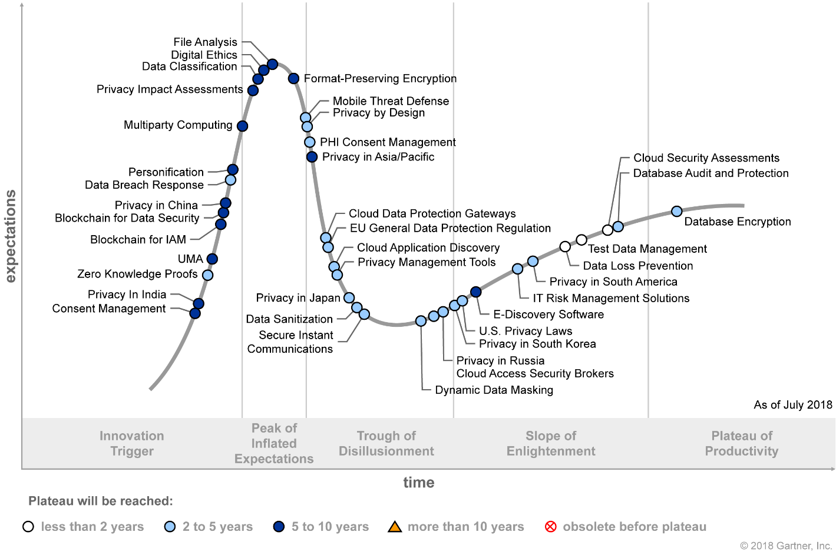
“Hype-Cycle” of GDPR
Notes:
Source: Gartner - https://www.gartner.com/document/code/338717
Zero Knowledge Proofs
Analysis By: David Anthony Mahdi
Definition: Zero knowledge proofs (ZKP) are privacy-preserving messaging protocols that enable entities to prove that information available to both of them is correct, without the requirement to transmit or share the underlying information. Blockchain platforms have been evolving to include this privacy-oriented mechanisms in the form of zk-SNARKs (a form of ZKP that does not require repeated interaction).
Position and Adoption Speed Justification: MIT first developed the concept of ZKP in the 1980s. In particular, the challenge was to overcome the possibility of fraudulent representation of information. Rather than just focusing on an entity (prover) who tries to persuade the receiver (verifier) that the information is accurate (either false or true), the goal is to also address the issue of a verifier learning more about the information than merely if it is accurate or not. This challenge has applicability in a wide range of use cases especially in the context of authentication and transaction verification. Other cases include payments, custody management, AML/KYC, medical records, mergers and acquisitions, etc.
To operate effectively, ZKP must have completeness (of process), soundness (of information), and zero knowledge (of anything other than the proof). This challenge is highly relevant to blockchains and distributed ledgers as a core tenet of their operation is data sharing. The zero-knowledge approach is used by blockchain platforms and cryptocurrencies in the form of zk-SNARKs, which are better-suited to a blockchain context due to greater efficiency and reduced need for interactivity. Hawk is an application of ZKP to smart contract domain, where the state of the computation is encrypted. An enabling cryptographic construct for ZKP is homomorphic encryption, which allows for computation on encrypted variables without revealing their values. Zcash (and its predecessor, Zerocash) is an early example of applying ZKP as an extension to the Bitcoin Protocol. In July 2016, Ethereum developers (such as Vitalik Buterin, the founder of Ethereum) worked in combination with ZKP experts to add a lightweight implementation of zk-SNARKs to the Ethereum platform, called ZoE. It is likely that future versions of Ethereum will incorporate a more robust ZKP capability. Over time, major platforms that seek to compete with Ethereum and bitcoin will add ZKP capability as well, and its value as a point of differentiation in a crowded competitive platform landscape will diminish.

Slide 67
Privacy Officers
Preparatory plan
Build relationships
Identify stakeholders
Campaign internally
Increase organizational understanding
Map out a plan for the future
Establish the Privacy Program
Maintain privacy documentation for business units and users
Establish a companywide mandatory reporting mechanism
Review existing personal-data-processing operations
Prioritize actions
Keep reputation for integrity, inside and outside the company
Notes:
Source: Gartner - https://www.gartner.com/document/code/313661
New worldwide regulations mandate that organizations add a privacy officer role, creating an unprecedented spike in demand for privacy experts.
Following a defined preparatory plan will help privacy officers build valuable relationships, increase organizational understanding, prioritize actions and map out a plan for the future.
Identify those stakeholders who benefit from a good privacy reputation or suffer from overly strict privacy controls.
Most privacy officers fail to accomplish these goals because they do not understand or meet business requirements and expectations, or they fail to communicate how they plan to meet these needs and expectations.
The success of a privacy officer lies in his or her reputation for integrity, inside and outside the company; the ability to provide the business with clear insights regarding risk-mitigating measures; and effectiveness in preparing useful records and metrics.
Recommendations - Security and risk management leaders responsible for a privacy management program should:
Install and maintain privacy documentation for business units and users, establishing transparency of the privacy management program.
Campaign internally so that all business units recognize and understand the privacy officer's position and responsibilities.
Establish a companywide mandatory reporting mechanism that encompasses new or changed personal-data-processing activities, and supports long-term compliance.
Review existing personal-data-processing operations to understand the organization's personal-data inventory and the relevant policies, using metrics to prioritize major privacy risks.

Slide 68
Incident Management
Incident Management

Slide 69


Recent Incidents
Notes:
https://techcrunch.com/2018/07/20/data-breach-level-one-automakers/
https://www.nytimes.com/2018/07/20/business/suppliers-data-leak-automakers.html
A security researcher came across tens of thousands of sensitive corporate documents — including many from nearly all of the largest auto manufacturers — on the open internet, unprotected. The trove included material from more than 100 companies that had interacted with a small Canadian company, Level One Robotics and Controls.
Among the documents were detailed blueprints and factory schematics; client materials such as contracts, invoices and work plans; and even dozens of nondisclosure agreements describing the sensitivity of the exposed information.
“That was a big red flag,” said Chris Vickery, the researcher who found the data. “If you see NDAs, you know right away that you’ve found something that’s not supposed to be publicly available.”
It was unclear whether anyone else had seen or downloaded the unguarded data, which included some personal information, such as scanned driver’s licenses and passports, on Level One employees but otherwise appeared to be confined to corporate secrets. Mr. Vickery alerted the company last week, and the exposed information was taken offline within a day.
But the inadvertent exposure of customers’ data illustrates a problem confounding businesses: Some of their biggest security risks come from their suppliers and contractors.

Slide 70
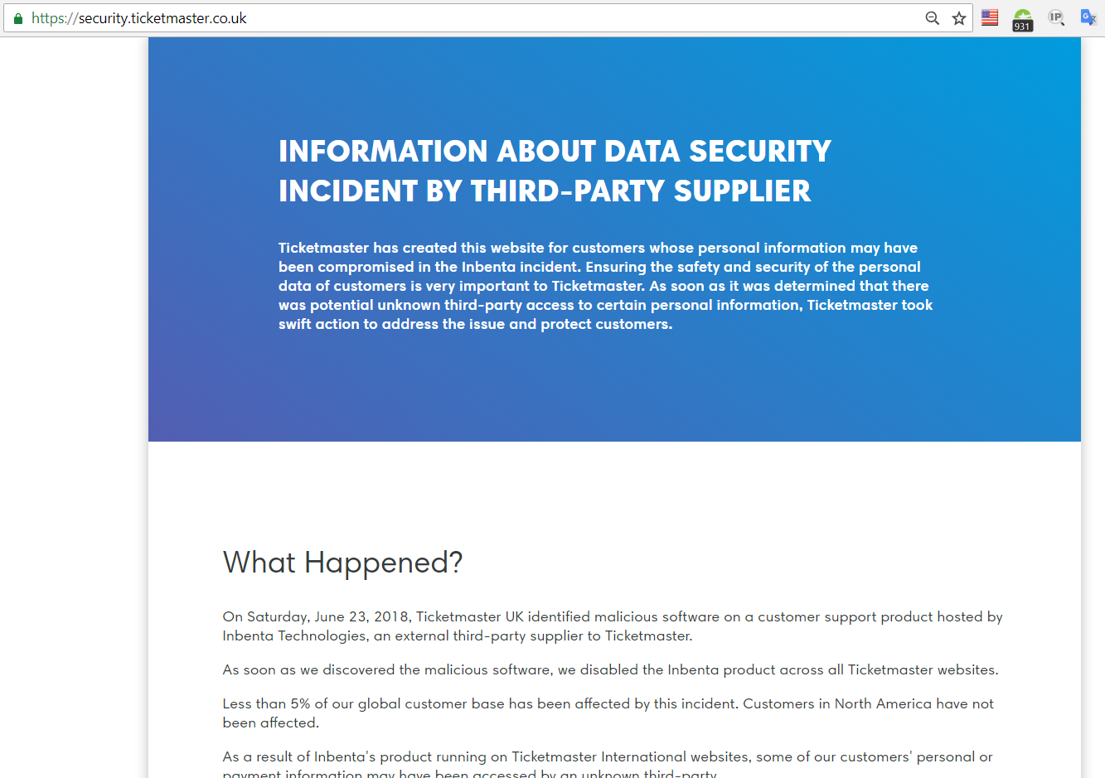
Recent Incidents
Notes:
Just last month, Ticketmaster revealed that payment information from thousands of customers had recently been stolen in a breach it attributed to flawed software from Inbenta, a company running customer support chatbots on TicketMaster’s website.
Fifty-six percent of the businesses polled last year by Ponemon Institute, a security research firm, said they had at some point experienced a data breach linked to a vendor. The exposure only grows as more third-party companies gain access: The survey’s respondents said an average of 470 outside companies had access to their sensitive corporate information, up from around 380 a year earlier.
“It’s relatively recently that C-level executives have begun to acknowledge that some of their third-party relationships are creating unbelievable risk,” said Larry Ponemon, the research firm’s founder.
The auto industry has a deep and complex supply chain, and third-party security risk is an area of growing concern, said Faye Francy, the executive director of the Automotive Information Sharing and Analysis Center, a trade group that focuses on cybersecurity.
Generally, automakers’ top security priority is vehicle risks, she said, such as vulnerabilities that could be used to attack a car’s critical components. Leaked corporate documents aren’t quite as fraught — “I doubt anyone is going to die over it,” Ms. Francy said — but the exposure of such information is still worrying.
“No one wants their data outside of their own company,” she said. “Anything that showcases how they manufacture is proprietary and competitive.”
Mr. Vickery, the director of cyber risk research at UpGuard, a security services company in Mountain View, Calif., has made a career out of hunting unguarded data caches.

Slide 71

Reporting to the CFO and Potential Investors

Slide 72
Key Findings from breached companies
Shares hit low point approximately 14 market days after breach
share prices -2.89% on average, underperform NASDAQ by 4.6%
After about a month, share prices rebound and catch up to NASDAQ performance
After first month, companies performed better than prior breach
six months before breach, average share price +3.64%, but is +7.02% after breach
underperformed the NASDAQ by 1.53% before breach, outperform it by 0.09% afterward
Finance and payment companies have largest drop in share price performance, Healthcare companies are the least affected
Highly sensitive information see larger drops in share price
Notes:
https://www.comparitech.com/blog/information-security/data-breach-share-price/
After about a month, share prices rebound and catch up to NASDAQ performance on average
After first month, companies analysed actually performed better than they did prior to the breach
In the six months leading up to a breach, average share price grew 3.64%, compared to 7.02% following a breach
Companies underperformed the NASDAQ by 1.53% leading up to the breach, but managed to outperform it by 0.09% afterward.
Finance and payment companies saw the largest drop in share price performance following a breach, while healthcare companies were least affected
Breaches that leak highly sensitive information like credit card and social security numbers see larger drops in share price performance on average than companies that leak less sensitive info

Slide 73
Dealing with a Breach
Plan for a security incident.
Determine and document your response priorities and escalation paths.
Brainstorm with members of the organization to think through various scenarios.
Draft messaging and corporate communications based on the scenarios.
Know which vendors are material to your operations.
Make sure that those involved in the response know what their roles will be and what authority they hold. Document it.
Exercise the plan at least twice per year — preferably quarterly. The more realism you inject into the exercise, the more likely it will execute smoothly in real life.
Notes:
Plan for a security incident.
Determine and document your response priorities and escalation paths.
Brainstorm with members of the organization to think through various scenarios.
Draft messaging and corporate communications based on the scenarios.
Know which vendors are material to your operations.
Make sure that those involved in the response know what their roles will be and what authority they hold. Document it.
Exercise the plan at least twice per year — preferably quarterly. The more realism you inject into the exercise, the more likely it will execute smoothly in real life.

Slide 74
Backup Slides
Backup Slides

Slide 75
GDPR Implementation Landscape

Slide 76
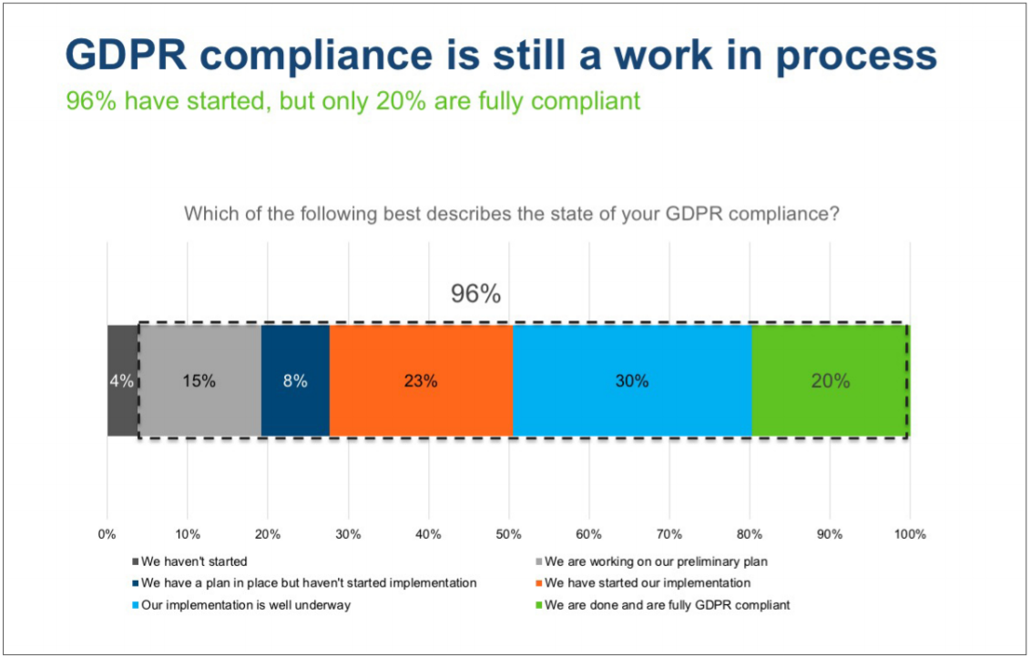
Notes:
Source: http://public.brighttalk.com/resource/core/207995/trustarc-gdpr-compliance-status-research-report-july2018-1_447252.pdf
GDPR Compliance Status A Comparison of US, UK and EU Companies - Independent research conducted by Dimensional Research on behalf of TrustArc – July 2018

Slide 77
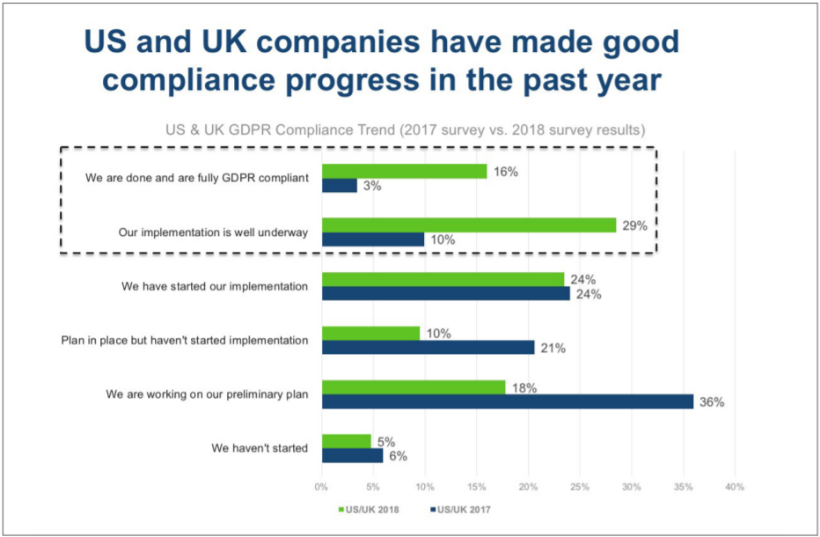

Slide 78
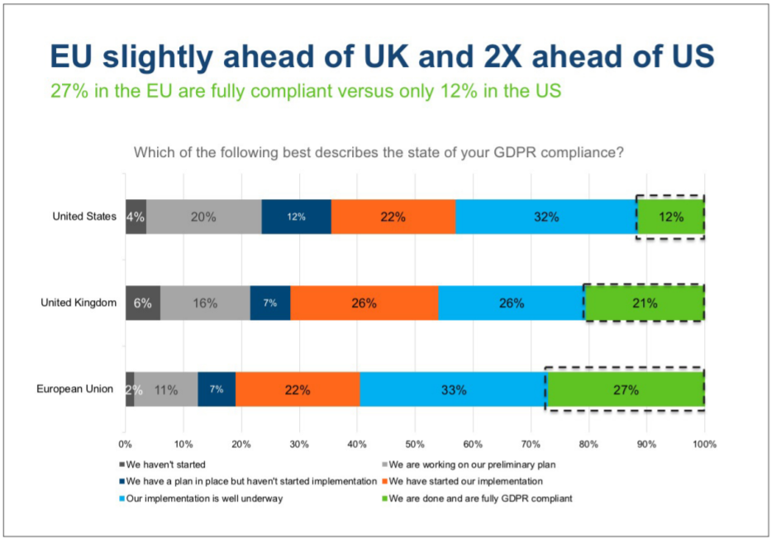

Slide 79
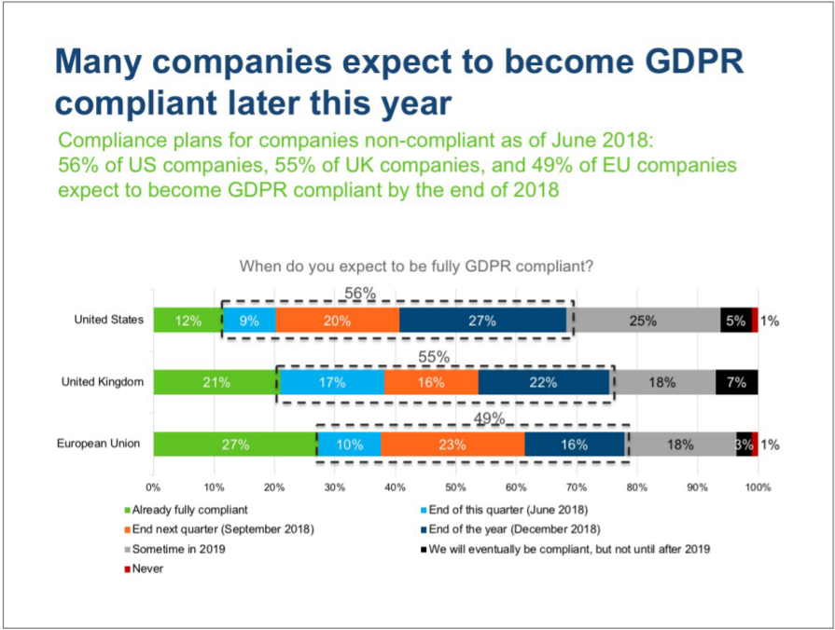

Slide 80
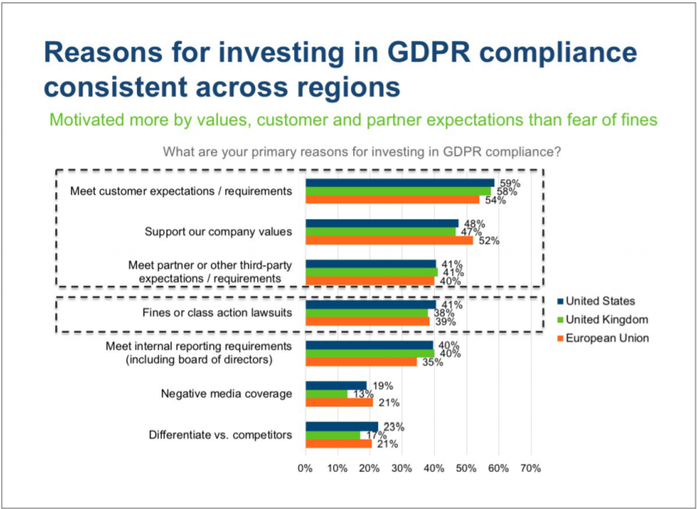
Notes:
Third-party comes on the third spot for reasons for GDPR compliance

Slide 81
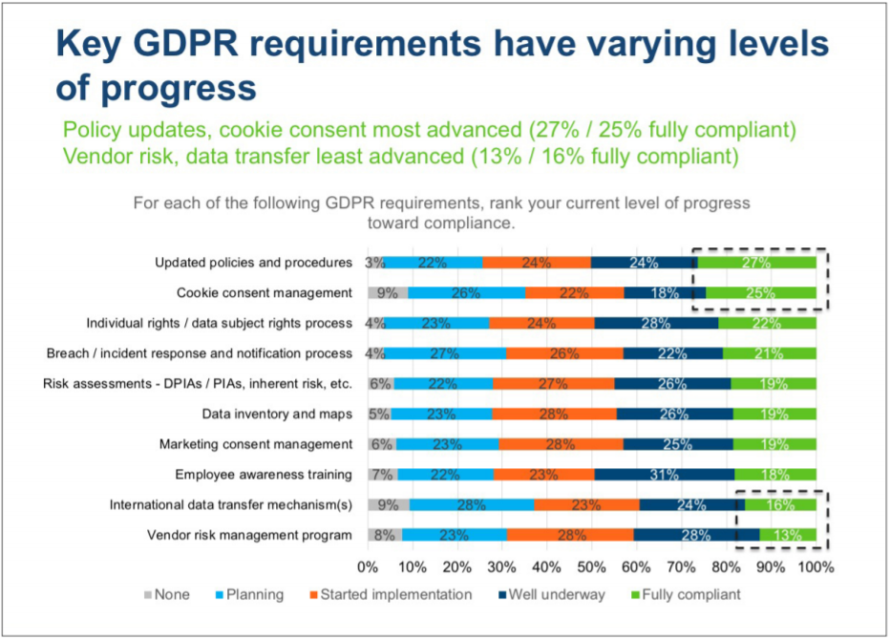

Slide 82
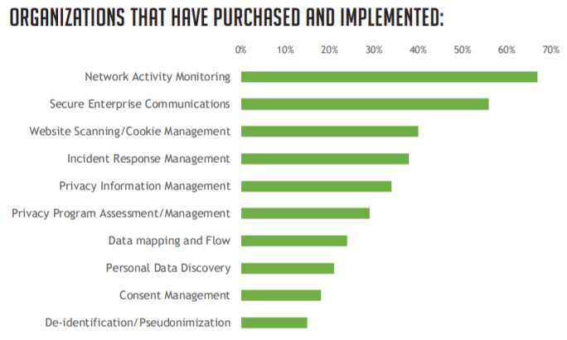
Notes:
Source: IAPP, TrustArc - http://public.brighttalk.com/resource/core/207996/iapp-trustarc-how-privacy-is-bought-used-final_447253.pdf

Slide 83
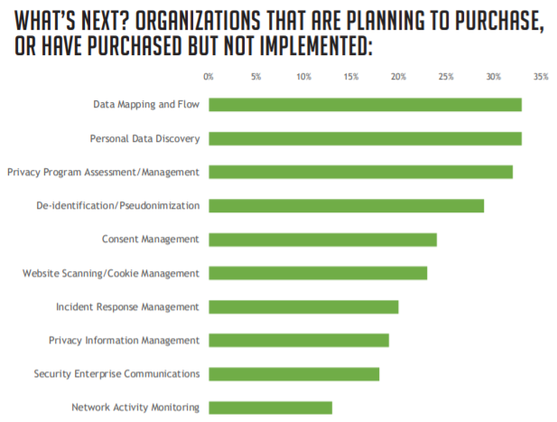

Slide 84
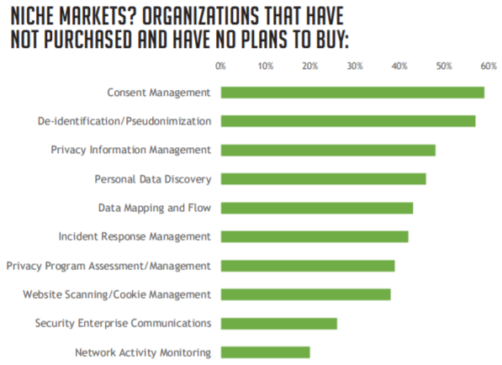

Slide 85
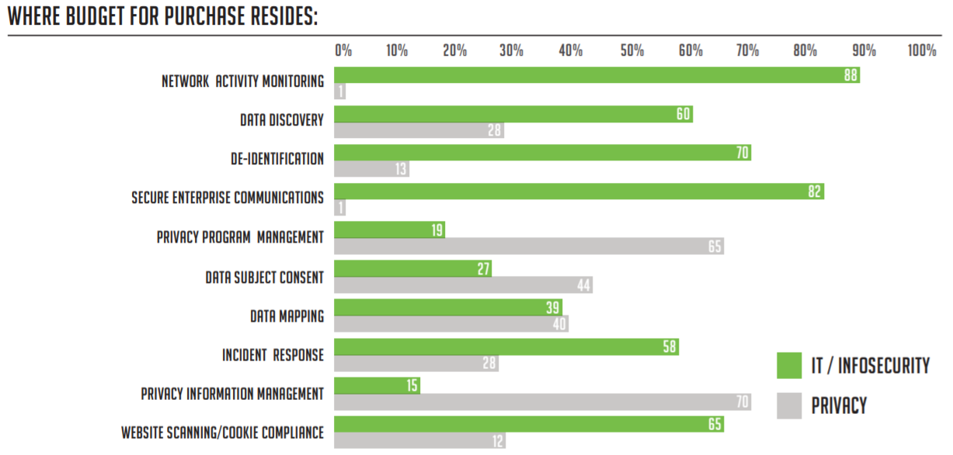

Slide 86
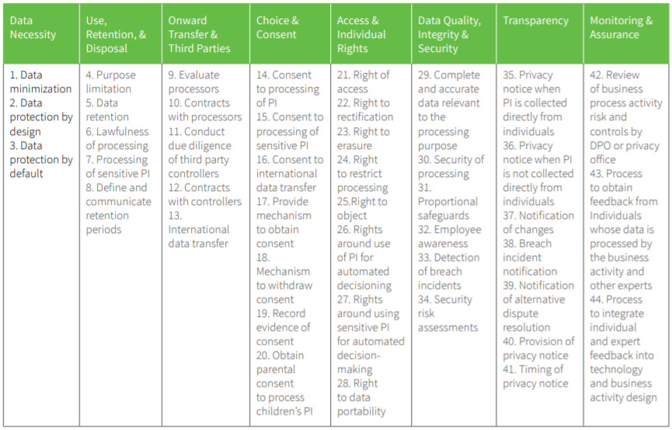
Practice Validation Requirements
Notes:
Record of processing activities.
Identity and access management will be at the heart of data compliance strategies post GDPR and essential to the digital, mobile, and cloud operating environments that will become the norm across all European industry sectors.

Slide 87
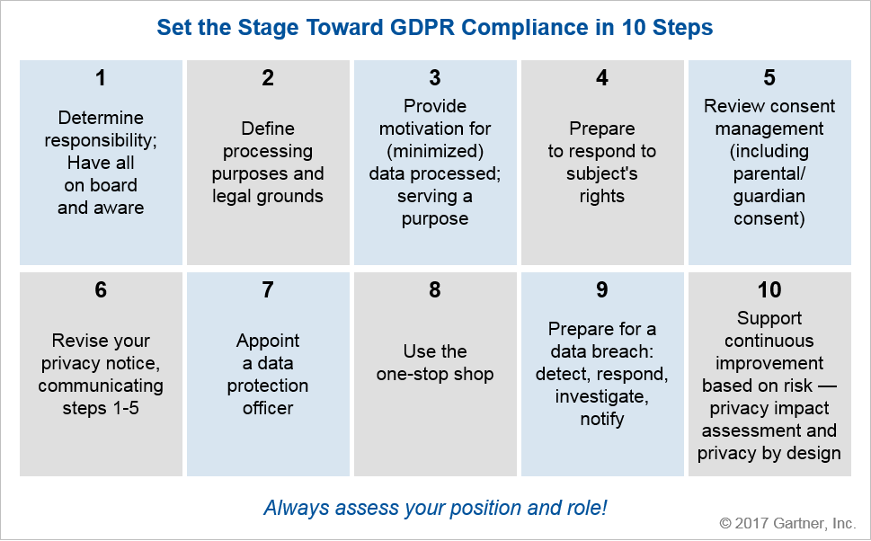
Gartner’s Recipe for GDPR Compliance
Notes:
Source: Gartner - https://www.gartner.com/document/code/333107

Slide 88
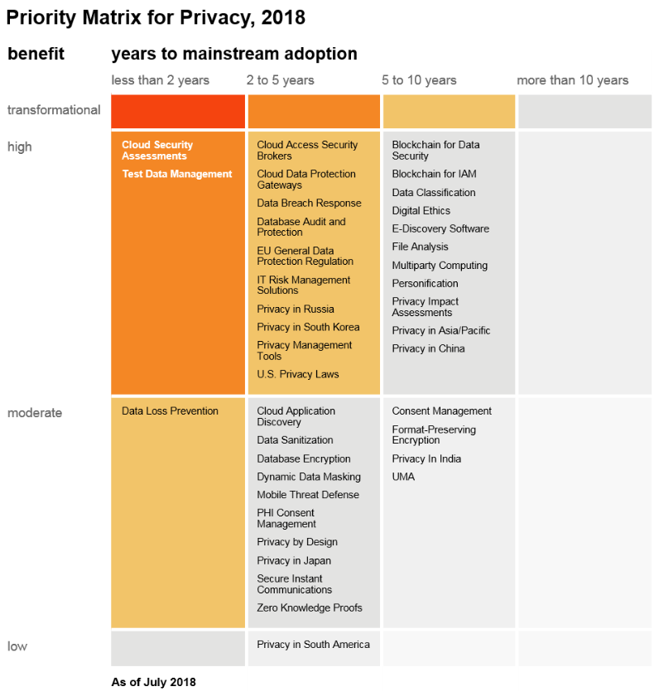
Gartner’s Priority Matrix for GDPR
Notes:
Source: https://www.gartner.com/document/code/338717

